Slide 2
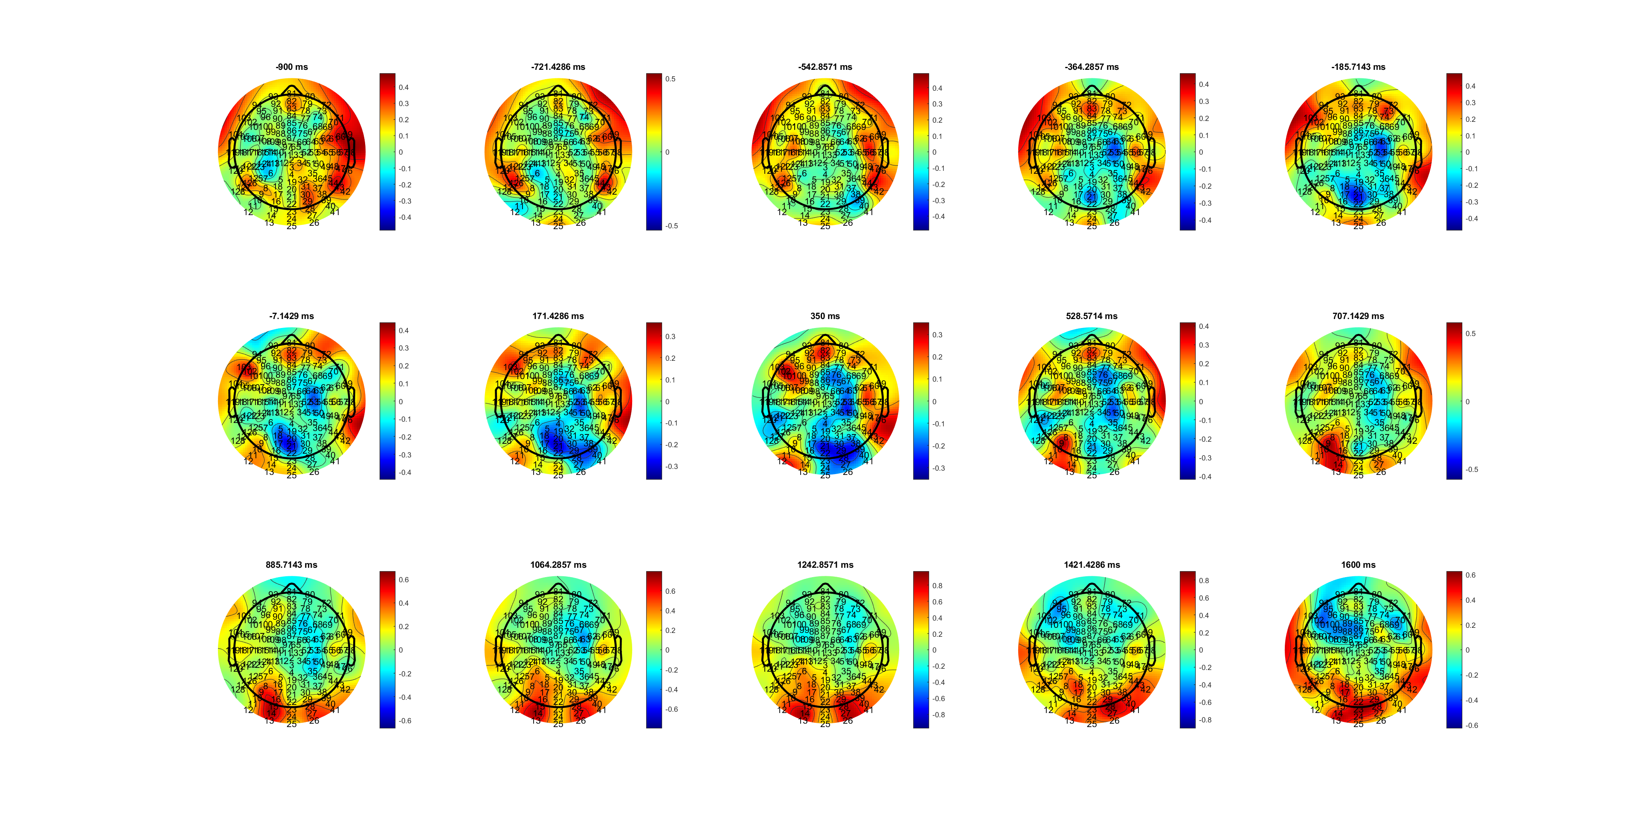
High Quick RT
MuBeta_SL_HL.mat

Slide 3
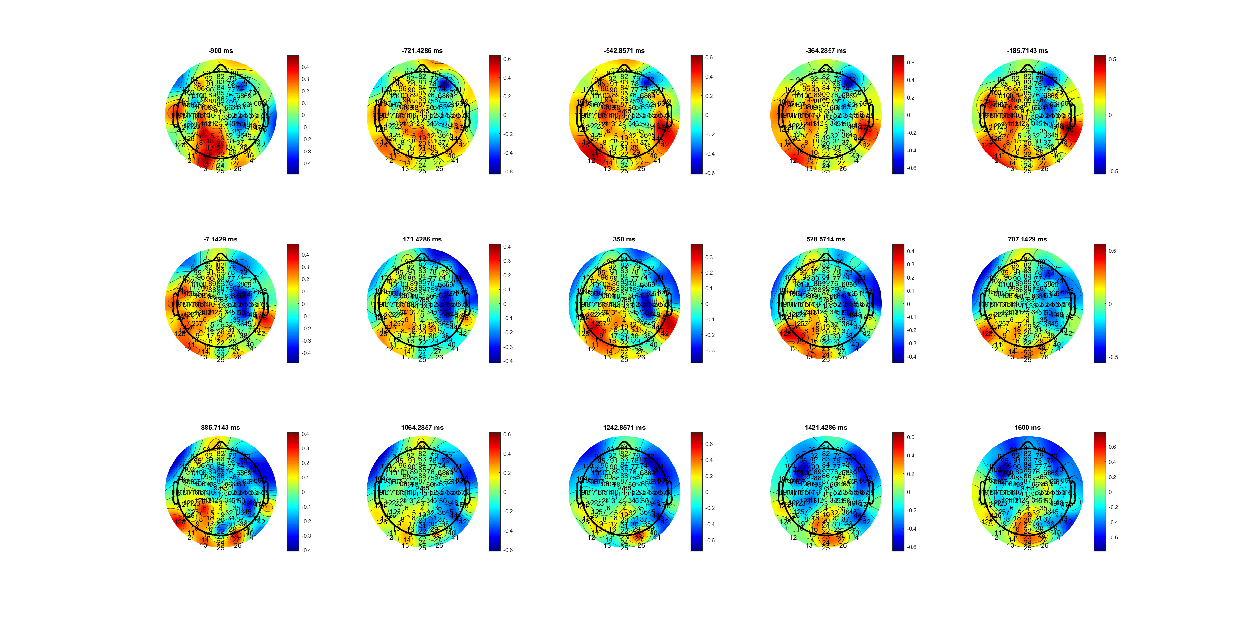
Low quickRT
MuBeta_SL_HL.mat

Slide 4
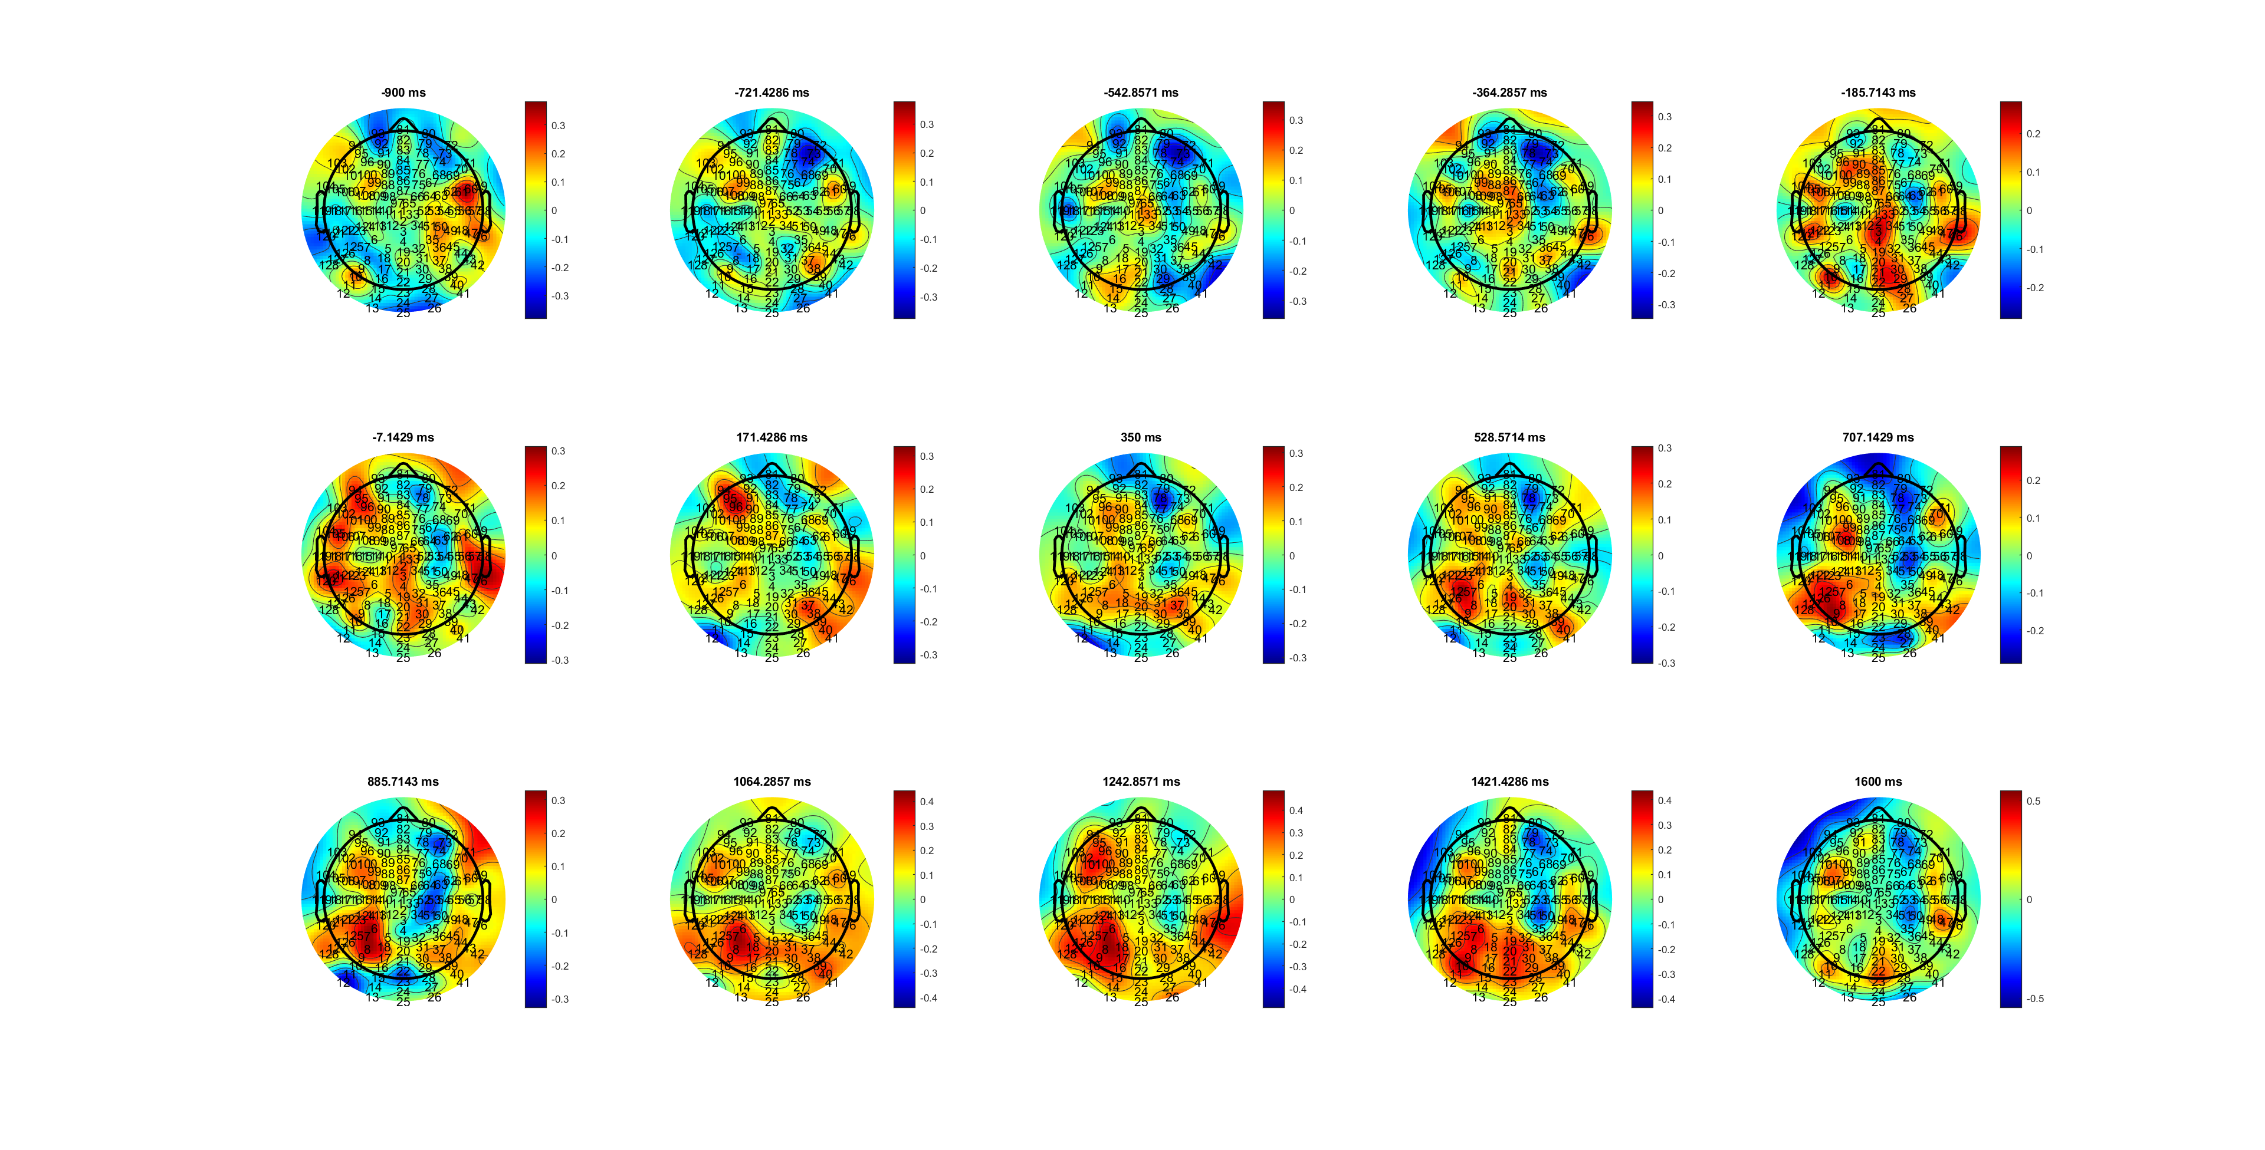
High Mid RT
MuBeta_SL_HL.mat

Slide 5
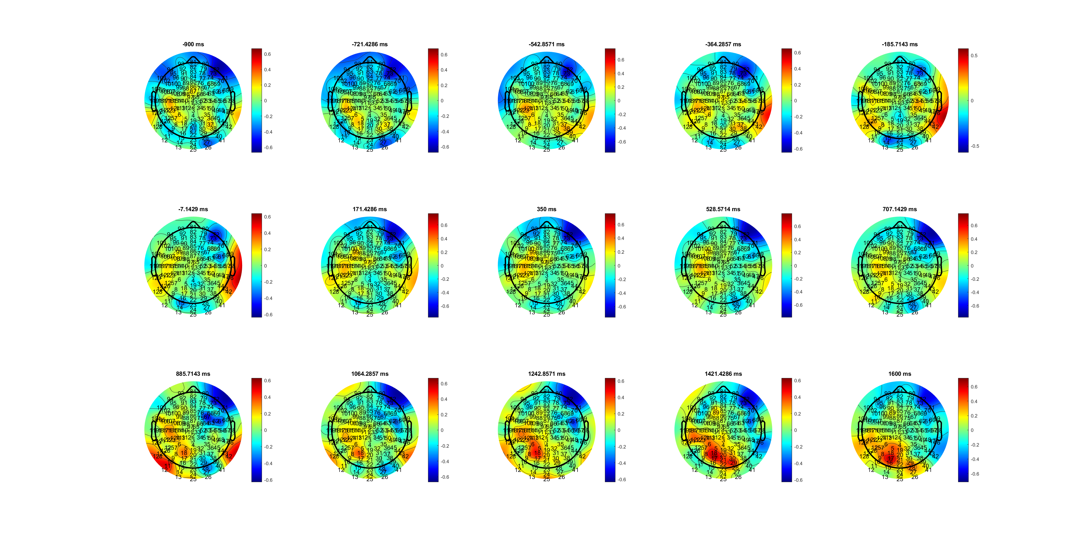
Low Mid RT
MuBeta_SL_HL.mat

Slide 6
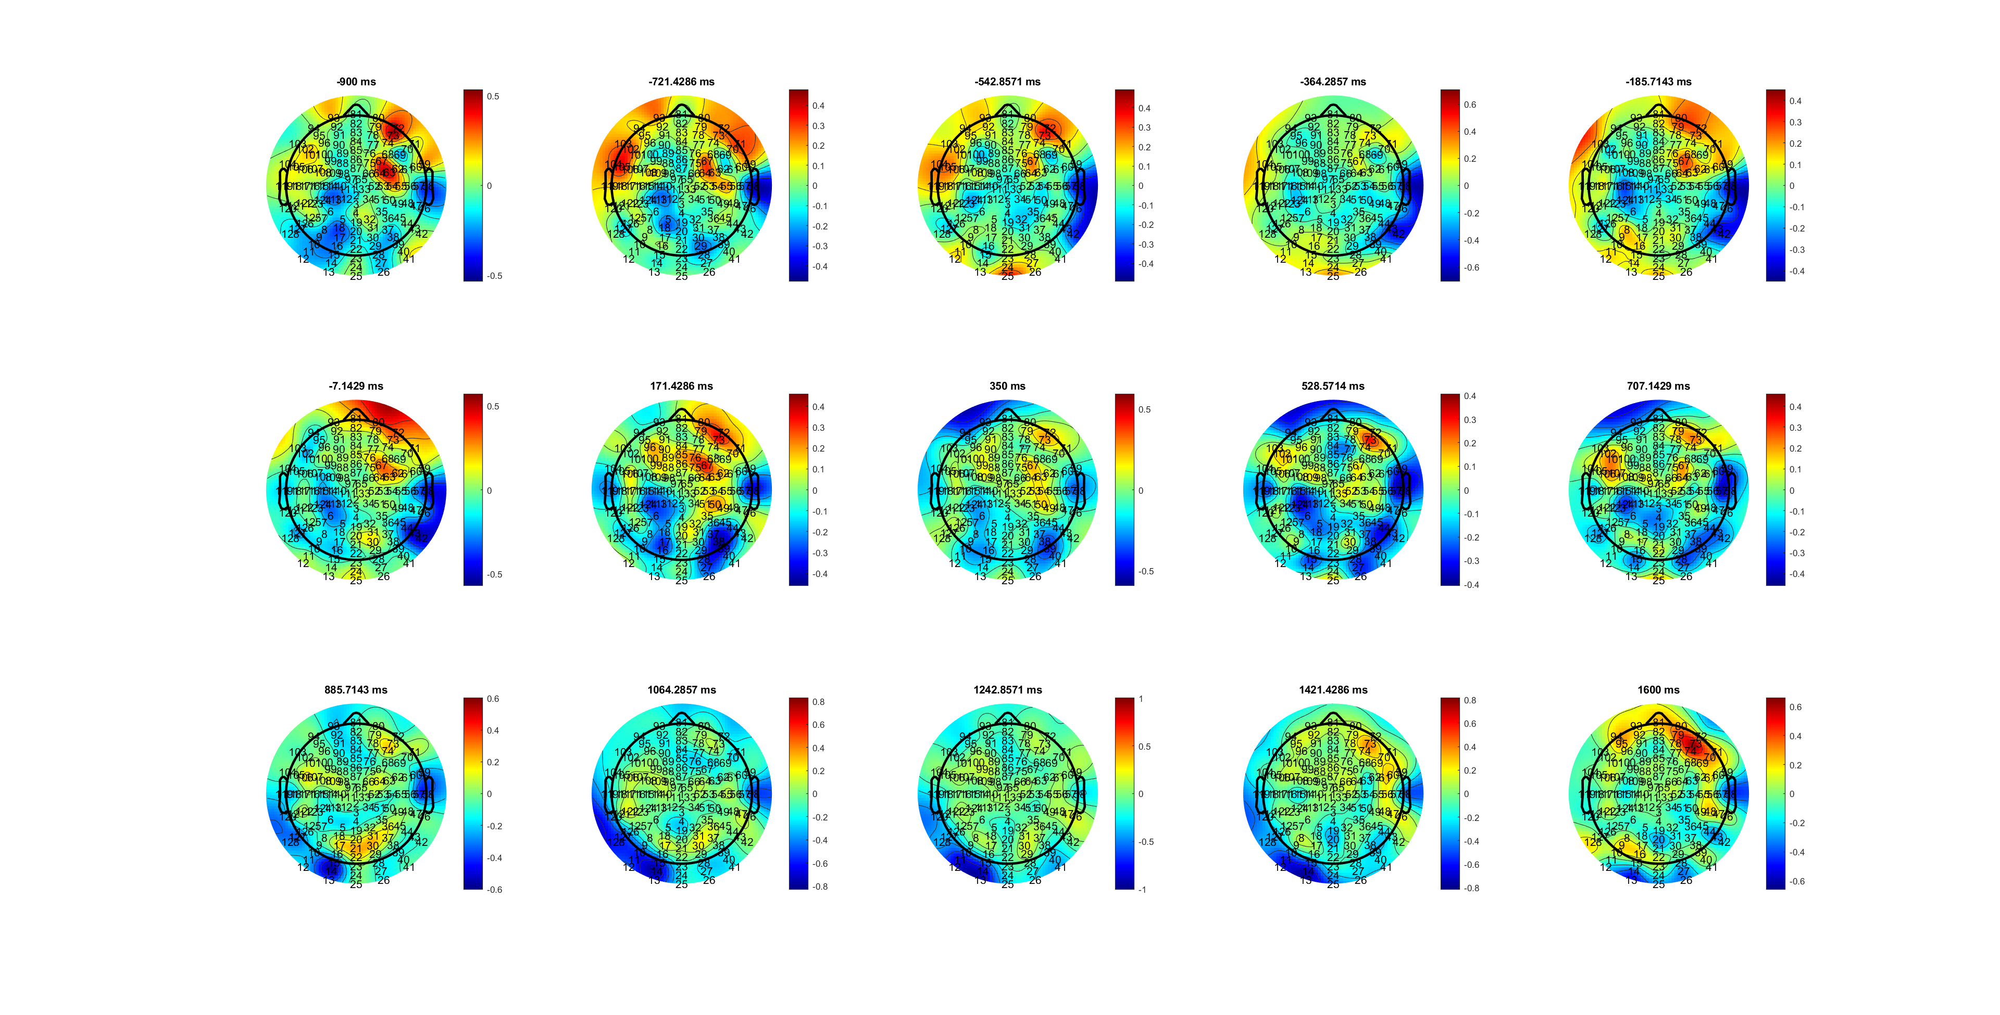
High Slow RT
MuBeta_SL_HL.mat

Slide 7
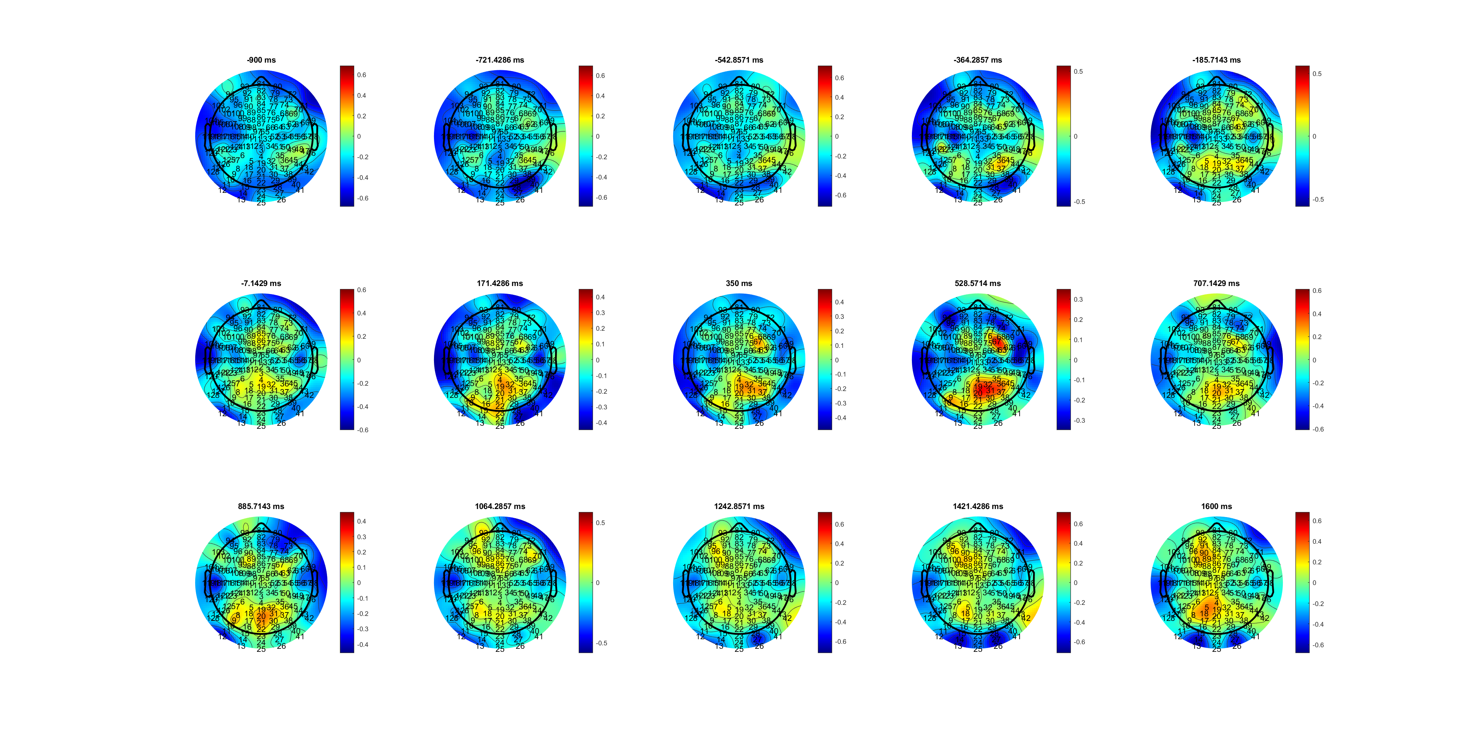
Low Slow RT
MuBeta_SL_HL.mat

Slide 8
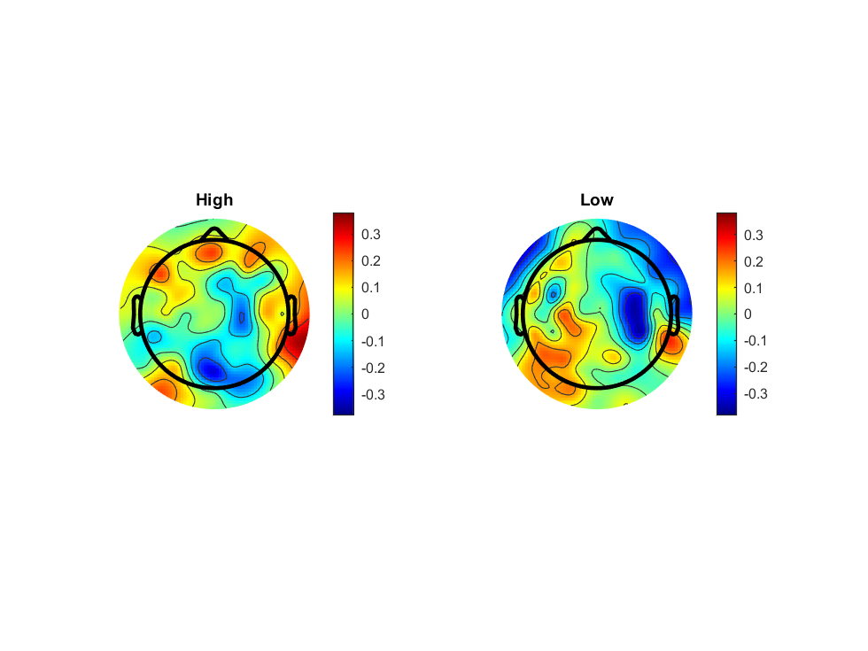
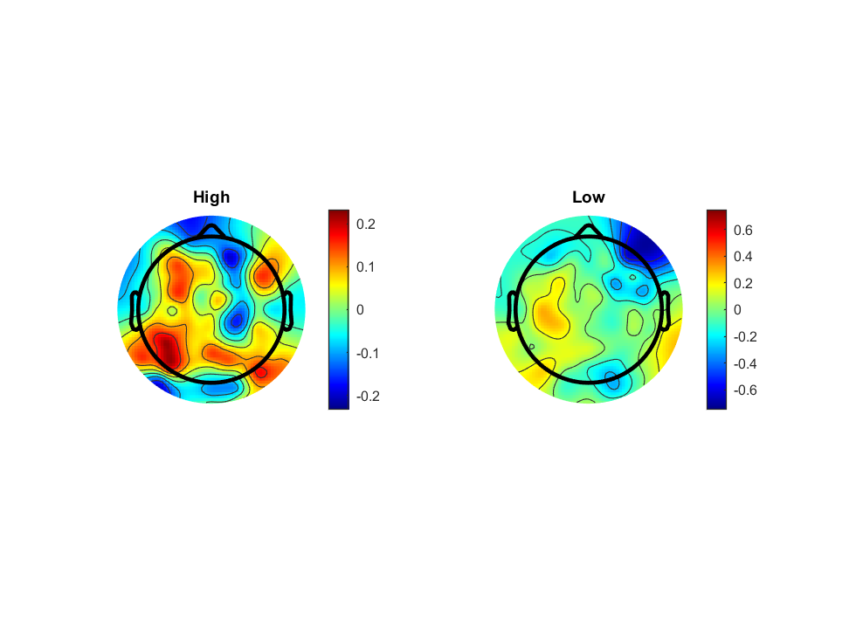
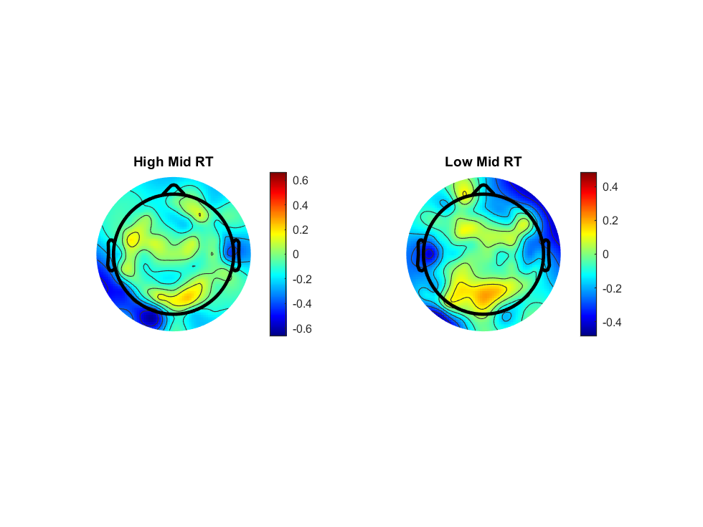
Slow RT not obervious
MuBeta_SL_HL.mat

Slide 9
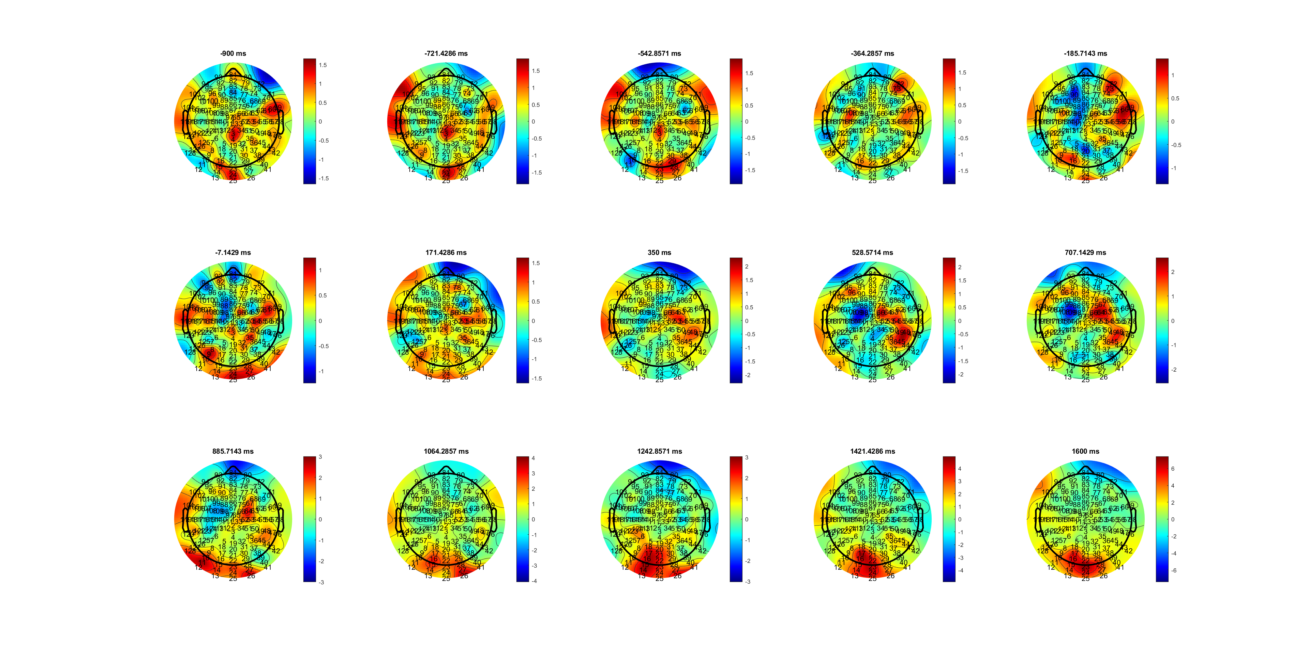
High RT
Delta_SL_HL.mat

Slide 10
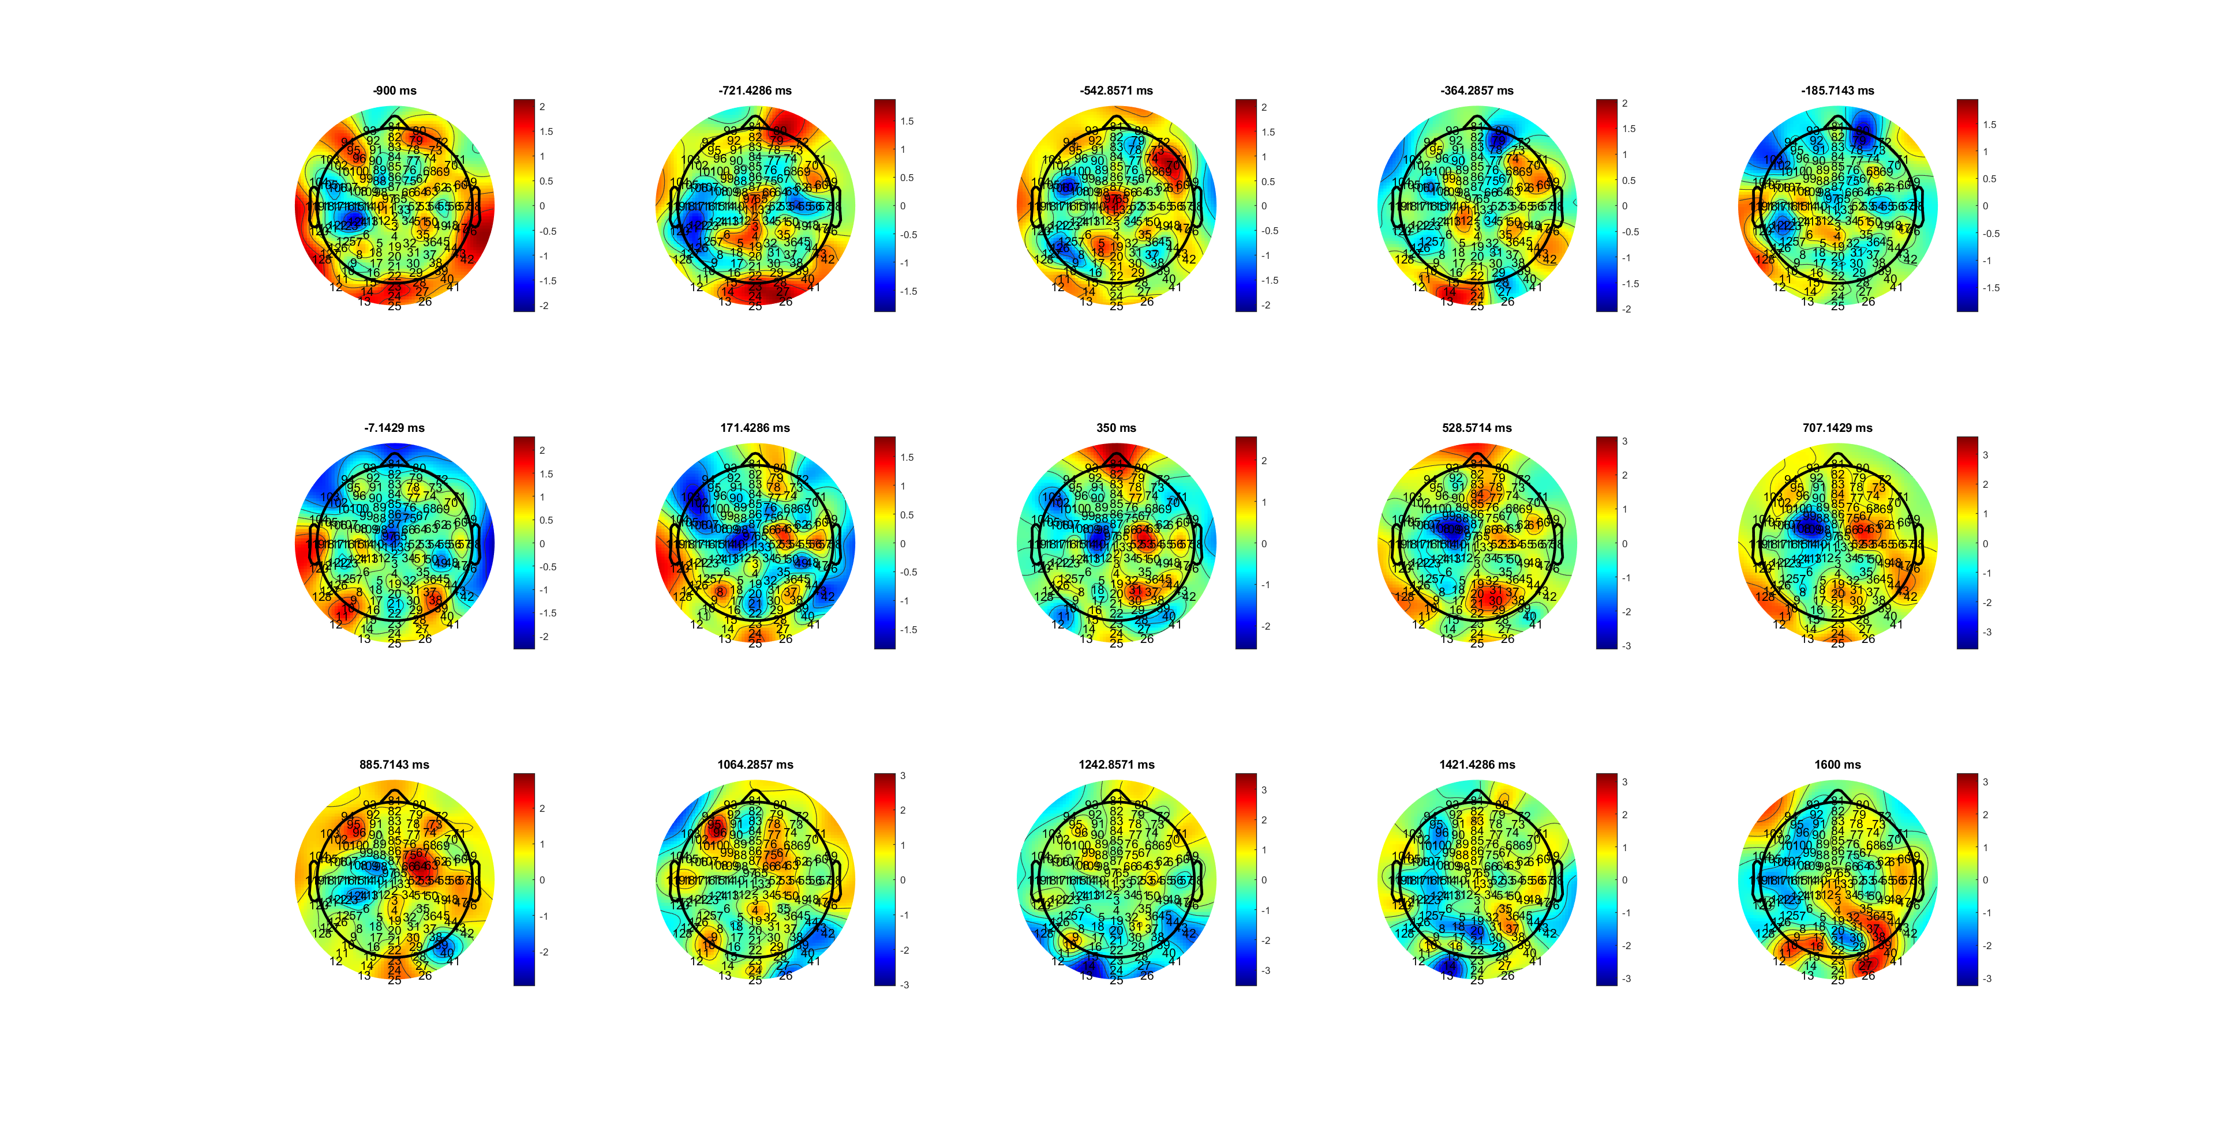
Low QRT (170-850ms)
Delta_SL_HL.mat

Slide 11
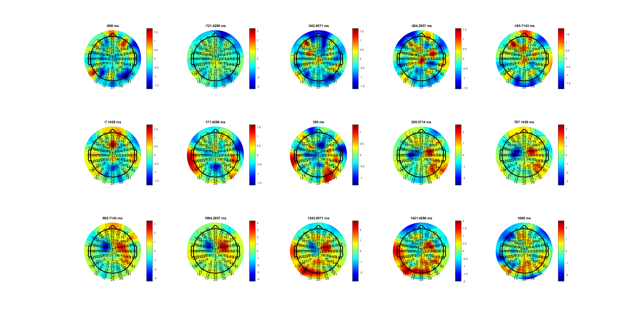
High MRT
Delta_SL_HL.mat

Slide 12
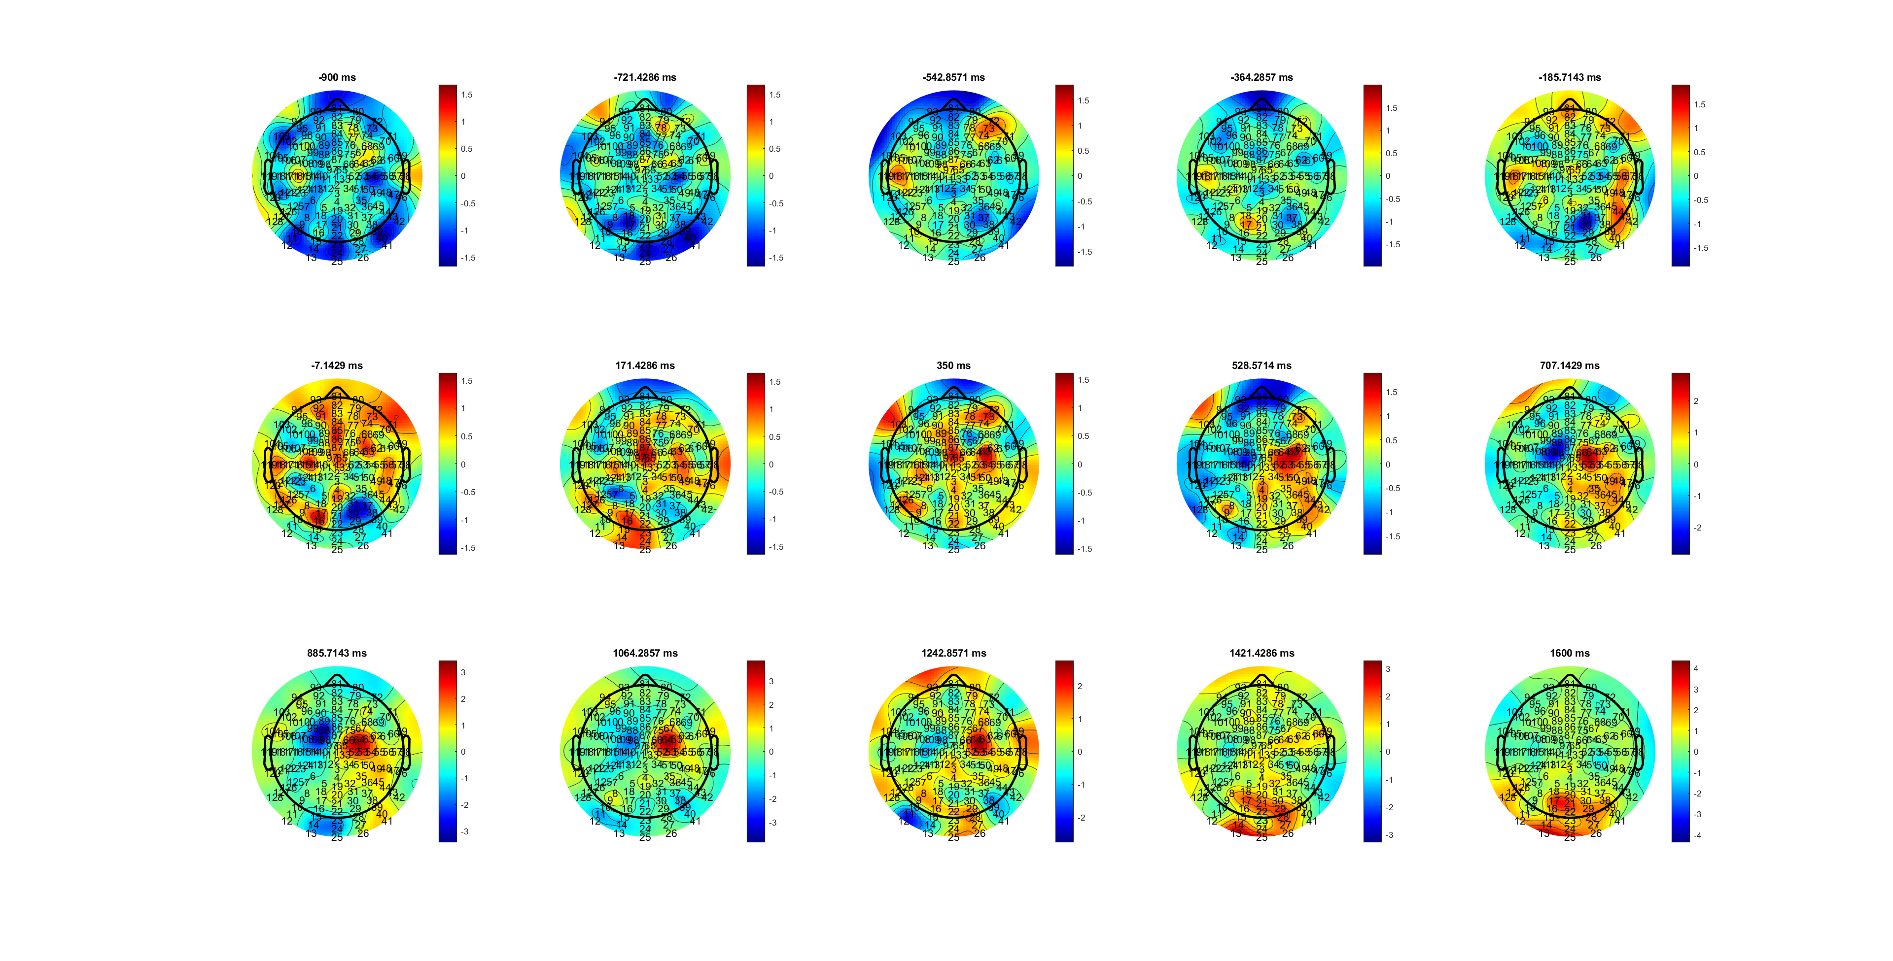
Low MRT(528-1200ms)
Delta_SL_HL.mat

Slide 13
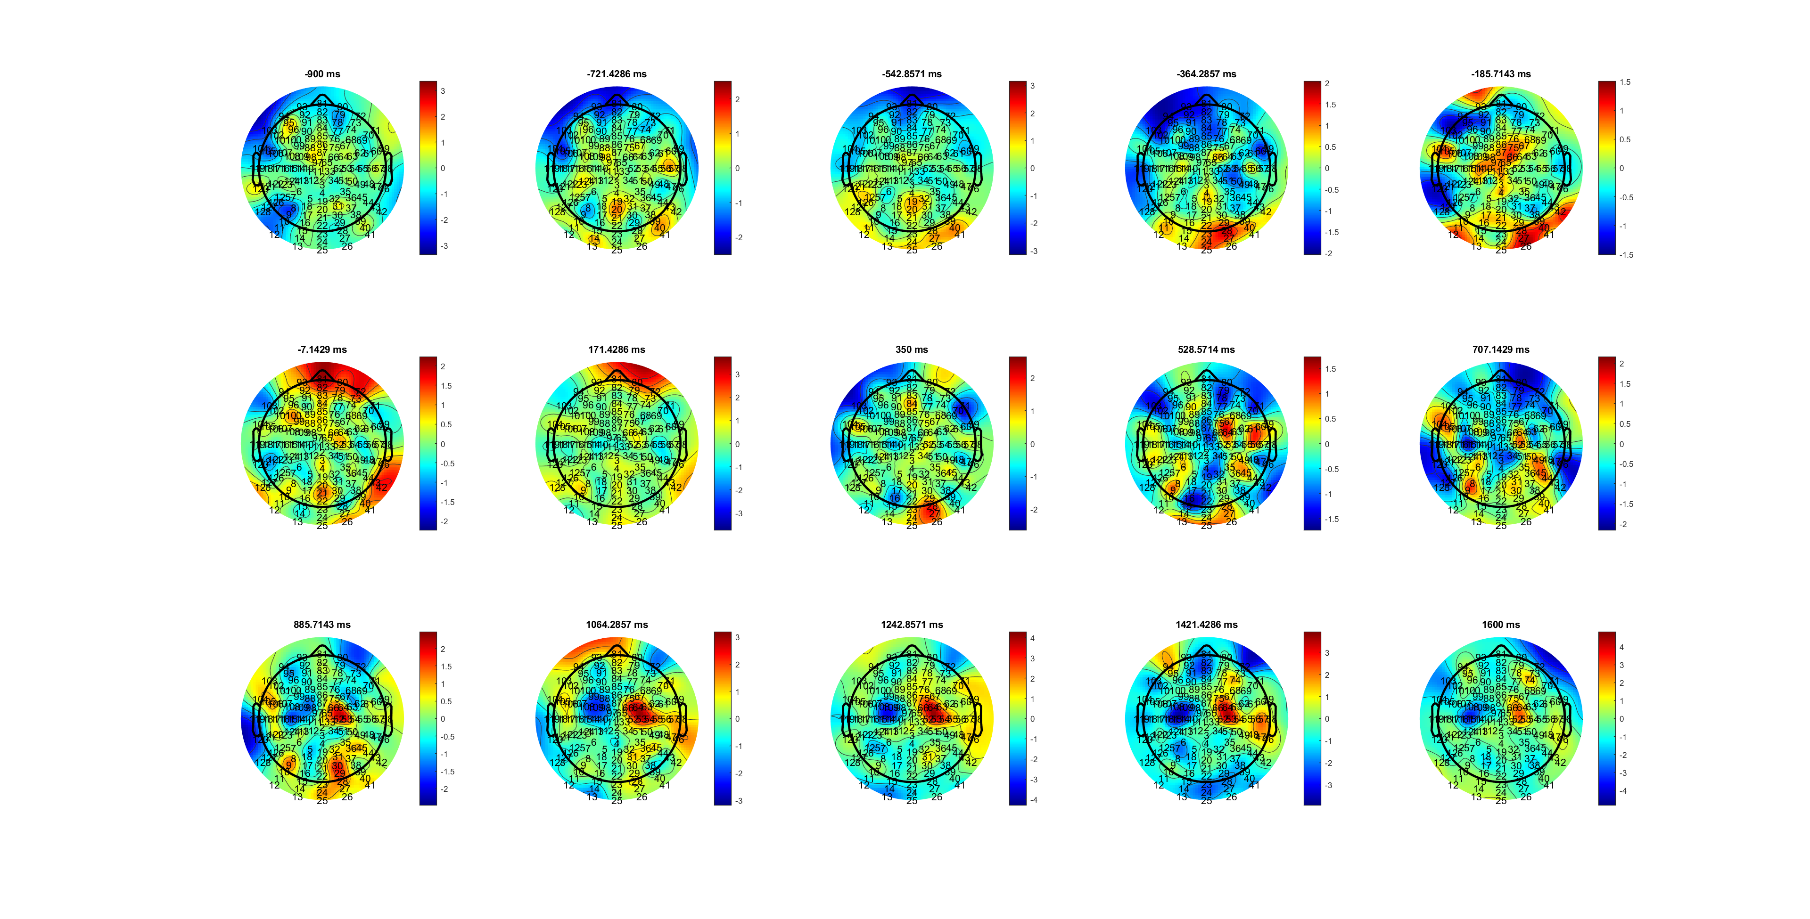
High SRT
Delta_SL_HL.mat

Slide 14
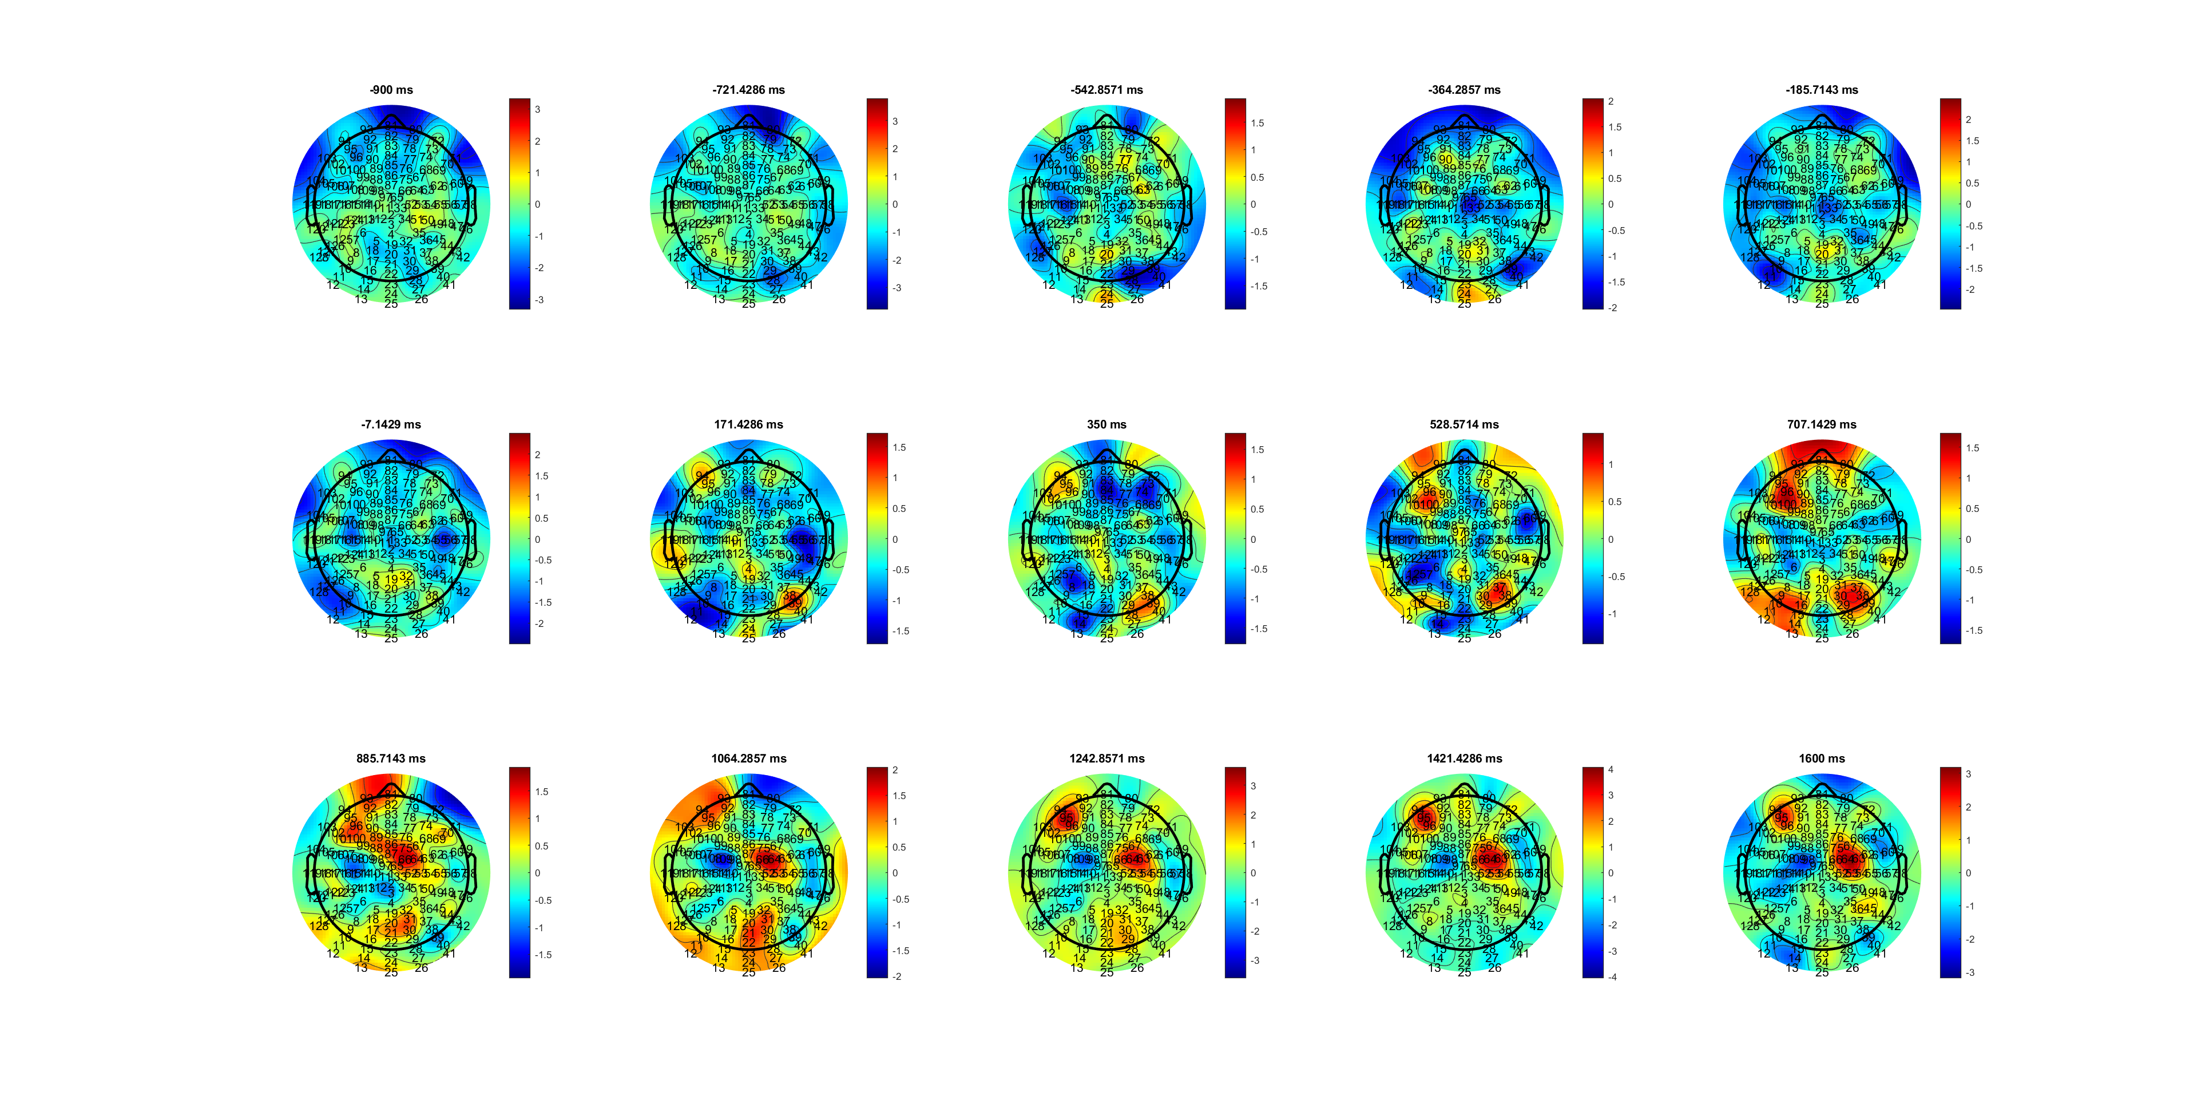
Low SRT (885-1600ms)
Delta_SL_HL.mat

Slide 15
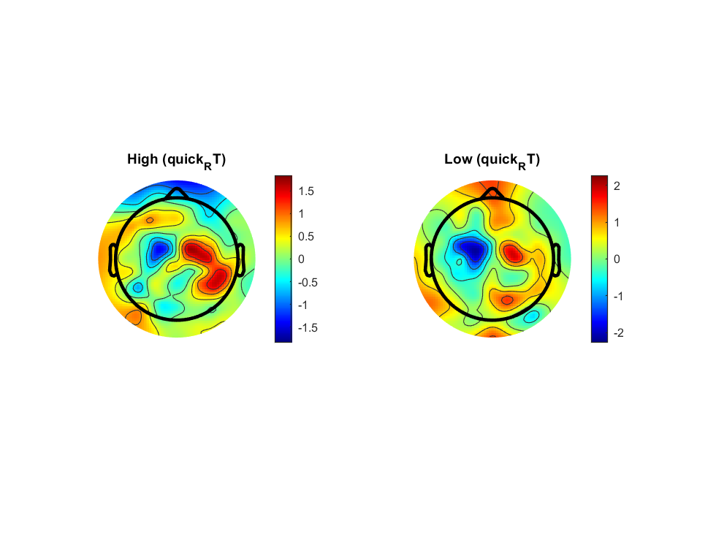
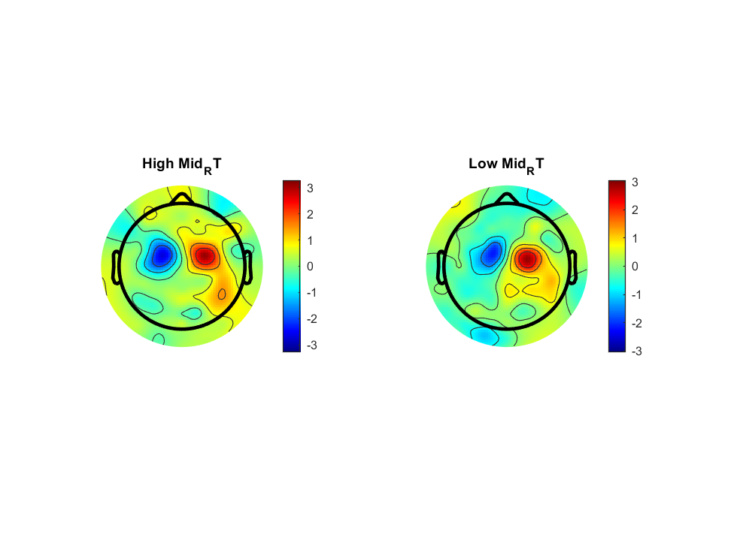
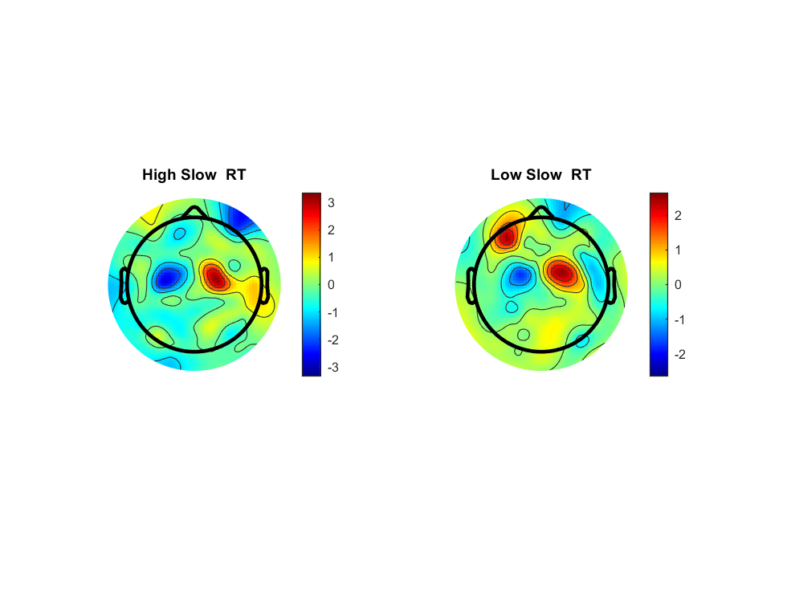
Delta_SL_HL.mat

Slide 16
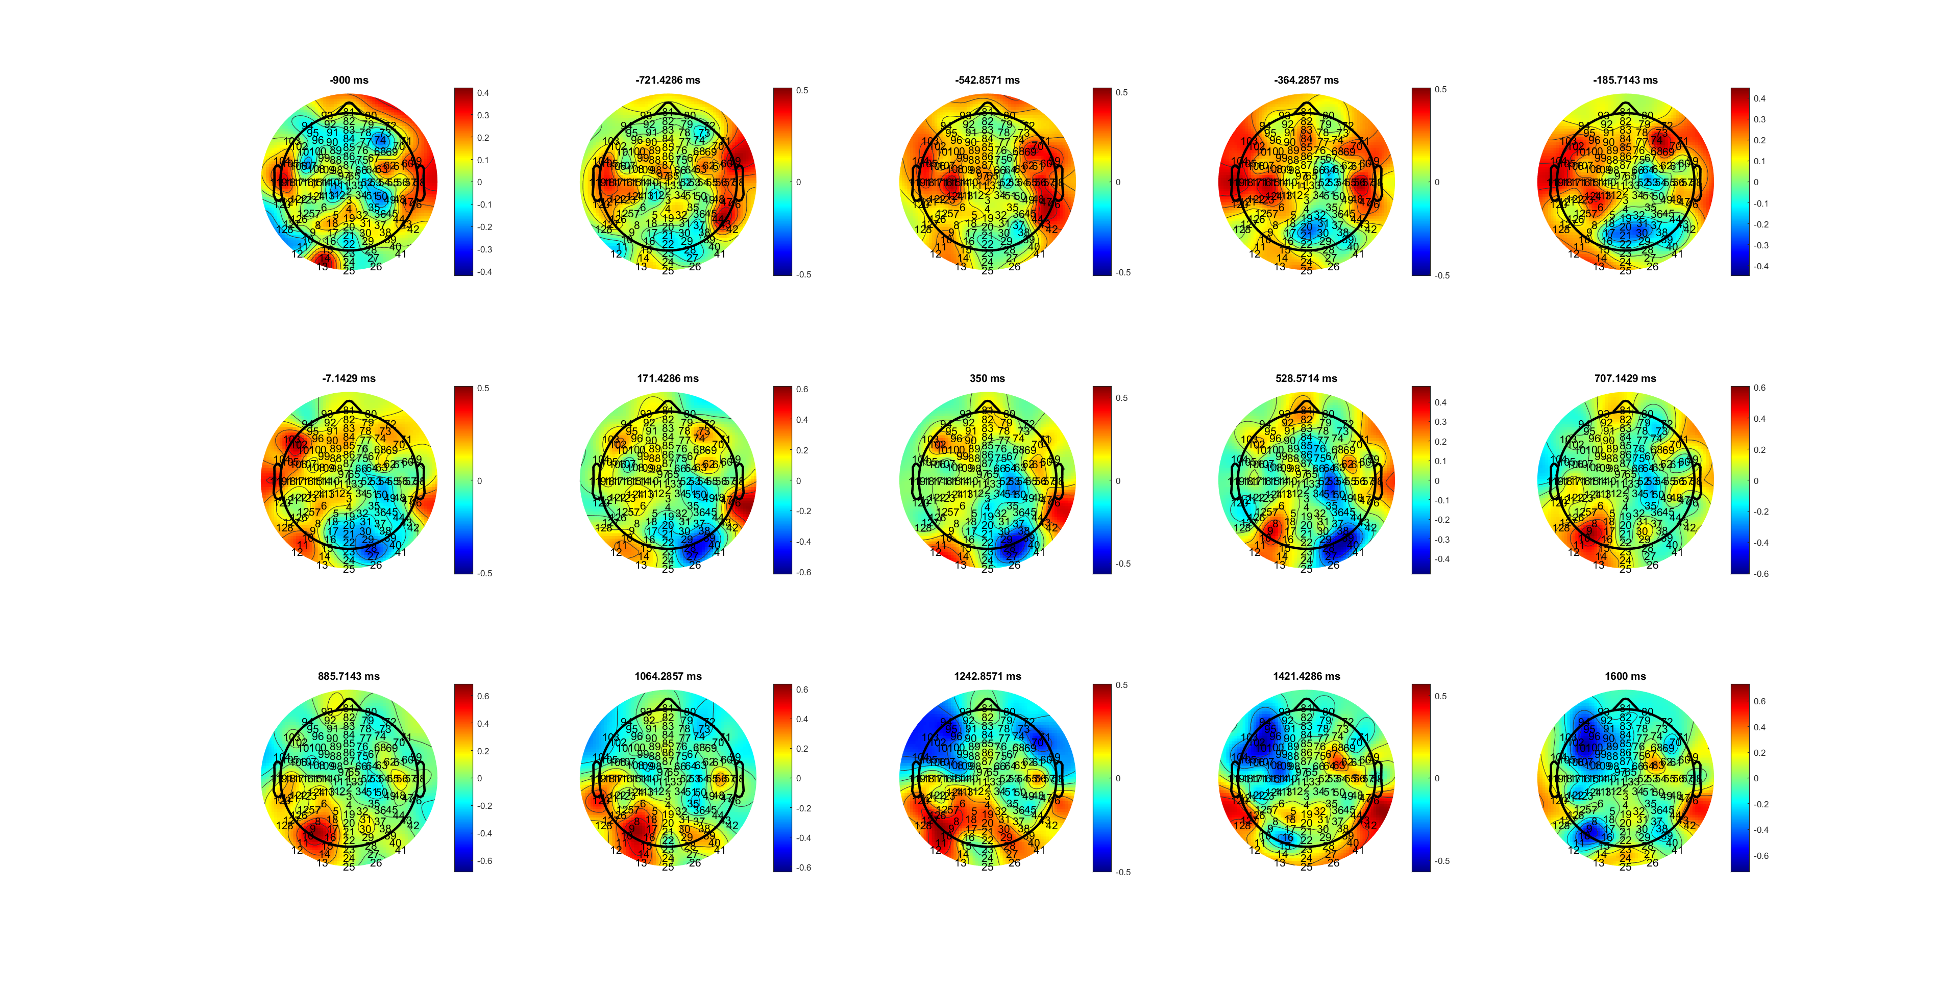
FDI QRT (300ms-700)
MuBeta_SL_FDIBCP.mat

Slide 17
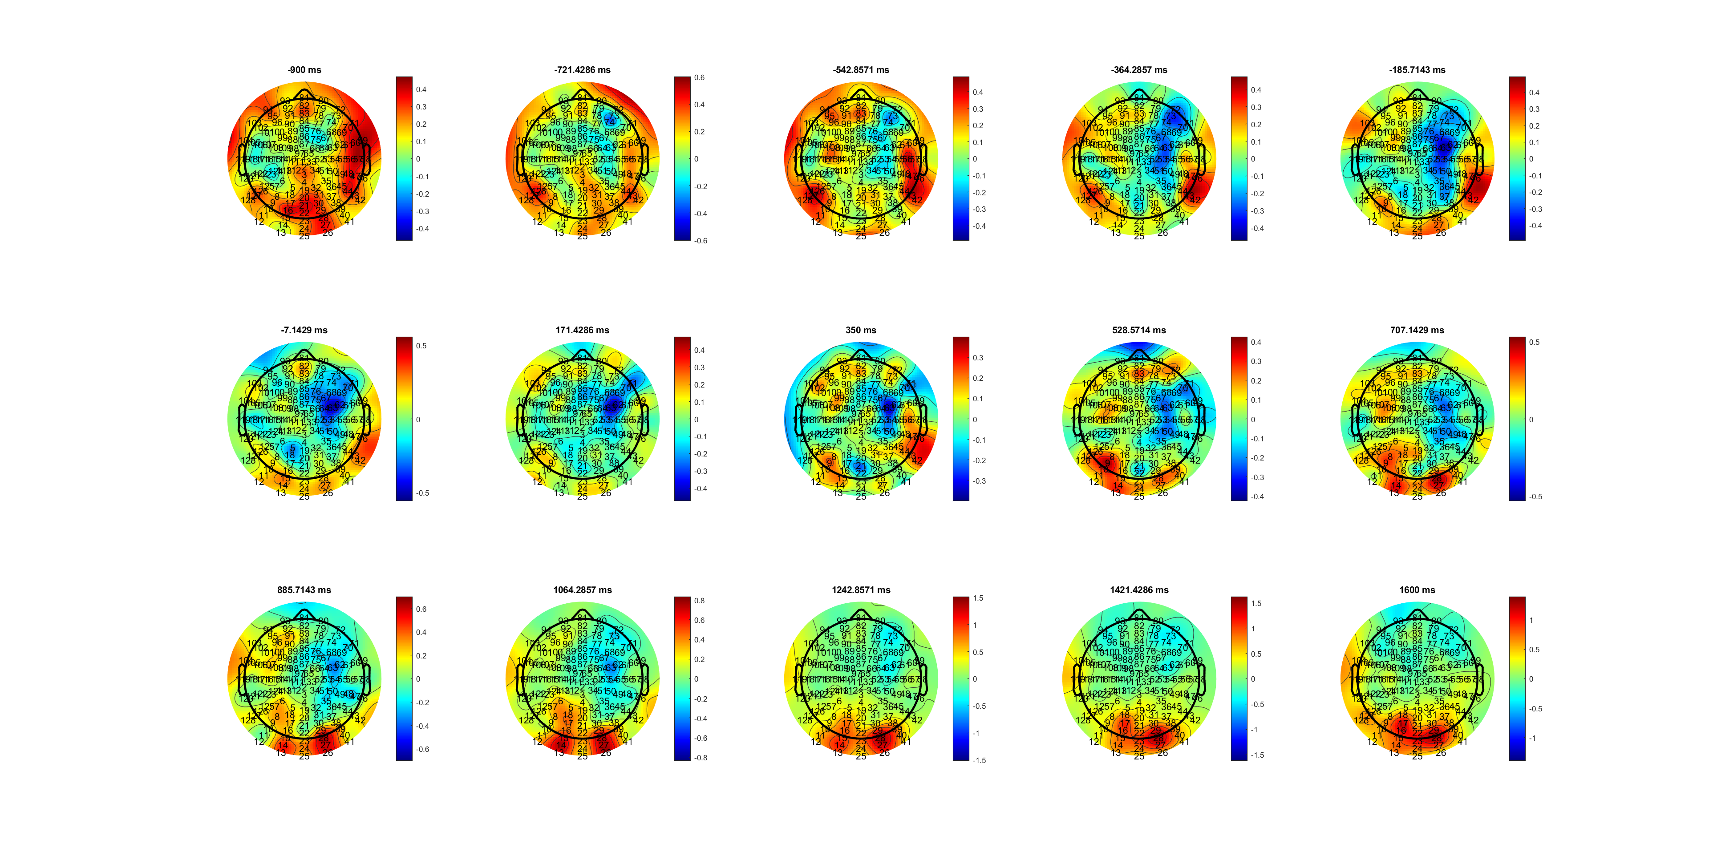
BCP QRT (350-900)
MuBeta_SL_FDIBCP.mat

Slide 18
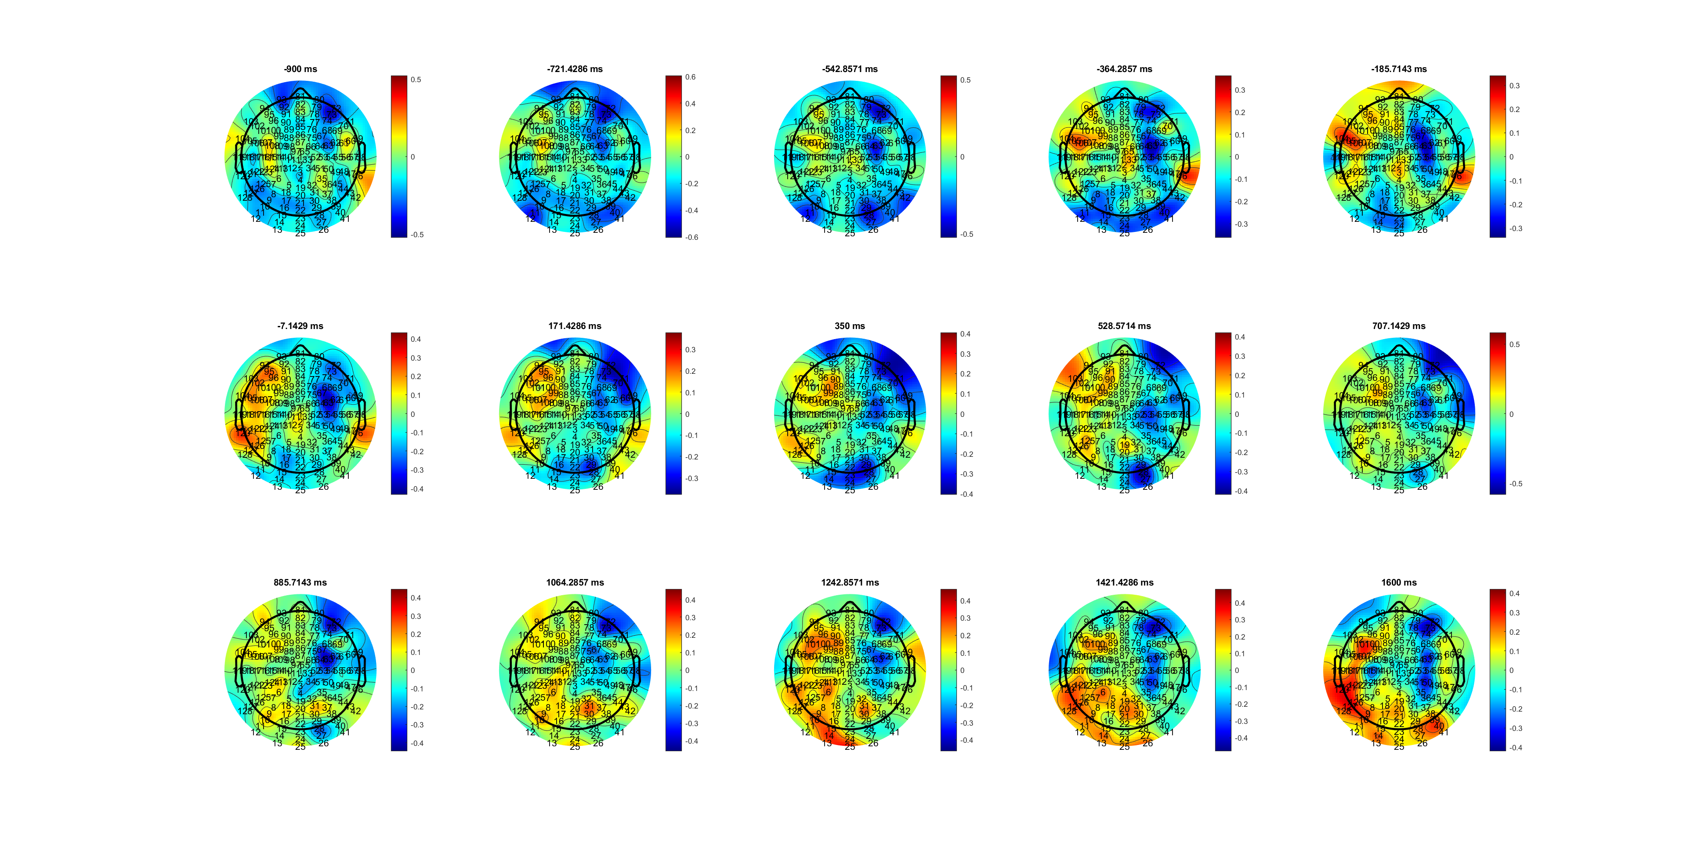
FDI MRT (-7-1200)
MuBeta_SL_FDIBCP.mat

Slide 19
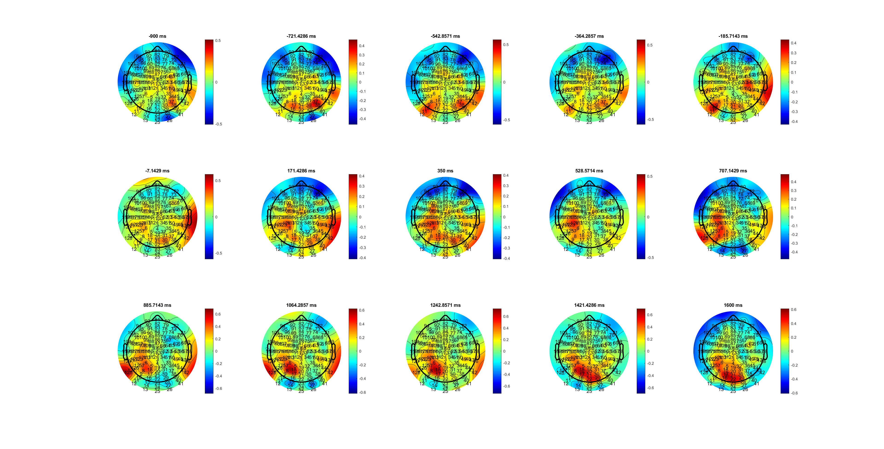
BCP MRT (350-1000ms)
MuBeta_SL_FDIBCP.mat

Slide 20
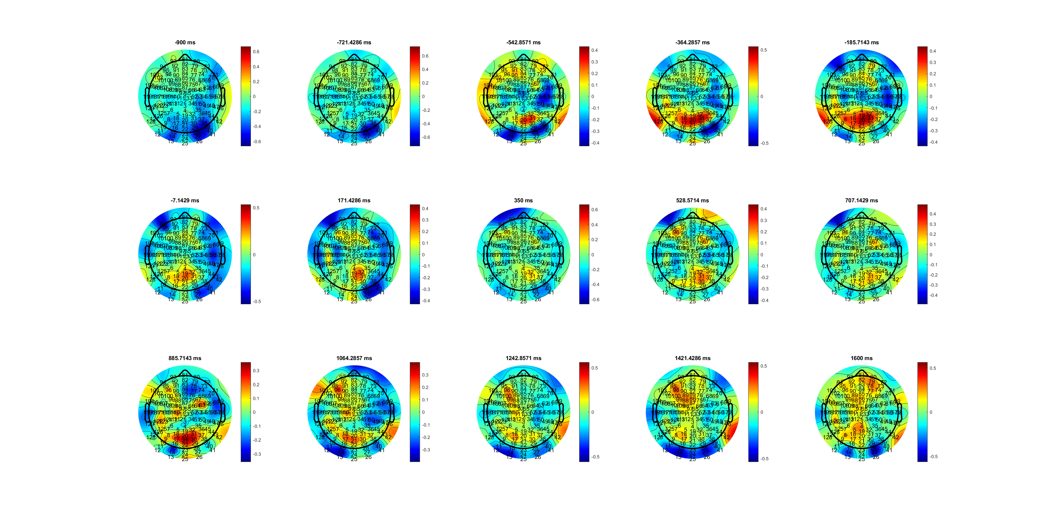
FDI SRT (800-1400)
MuBeta_SL_FDIBCP.mat

Slide 21
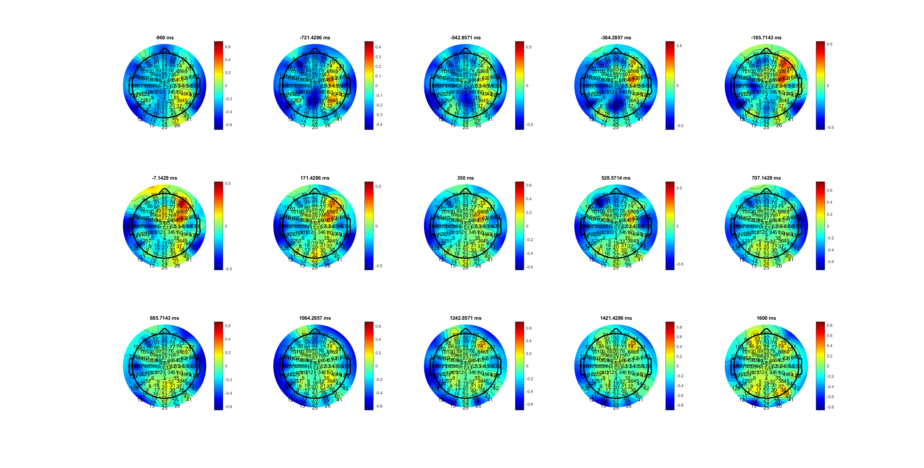
BCP SRT (350-528)
MuBeta_SL_FDIBCP.mat

Slide 22
FDI range + and early
BCP range – and same time
MuBeta_SL_FDIBCP.mat

Slide 23
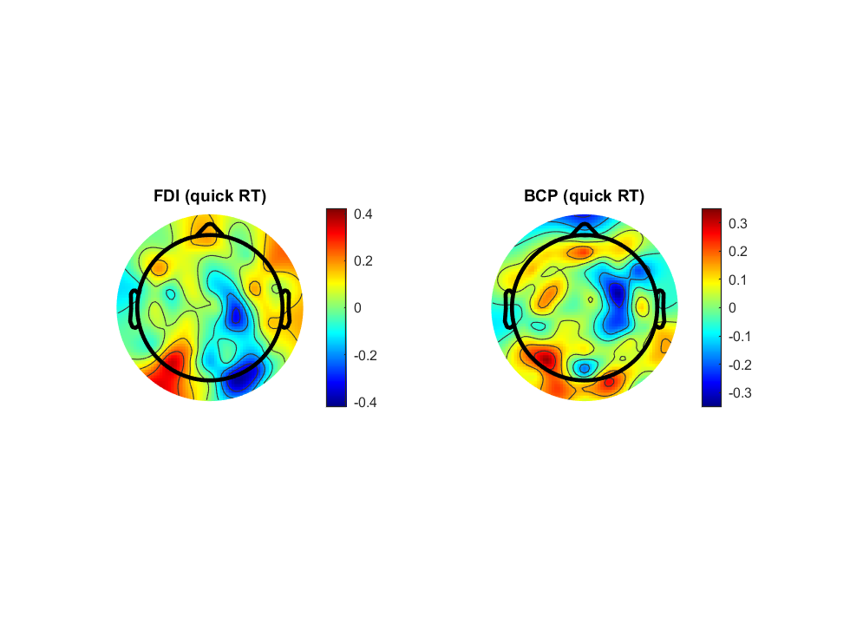
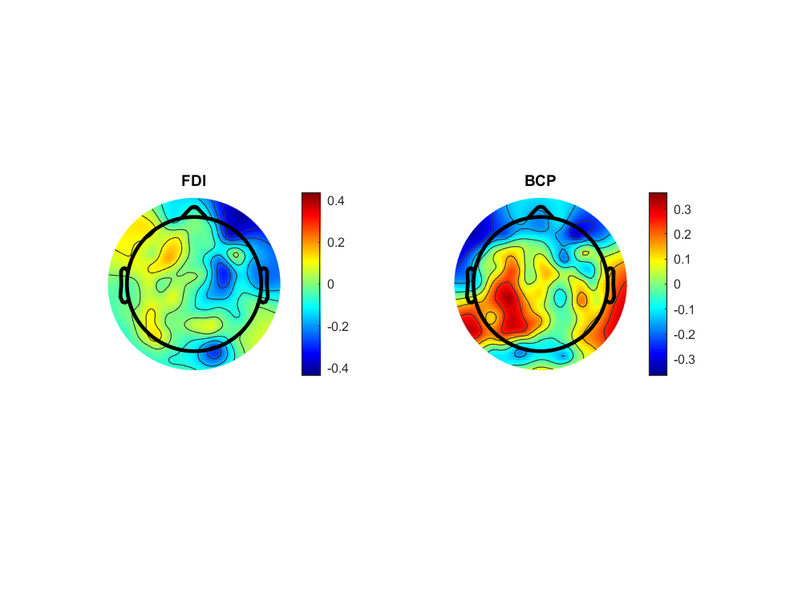
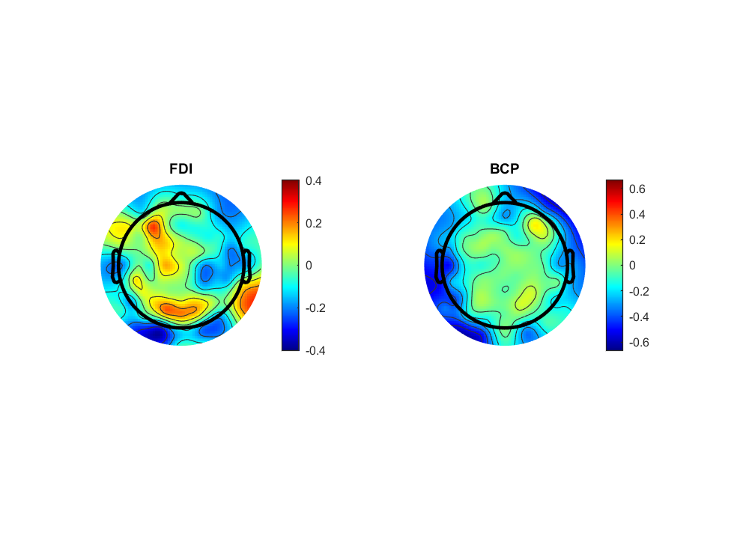
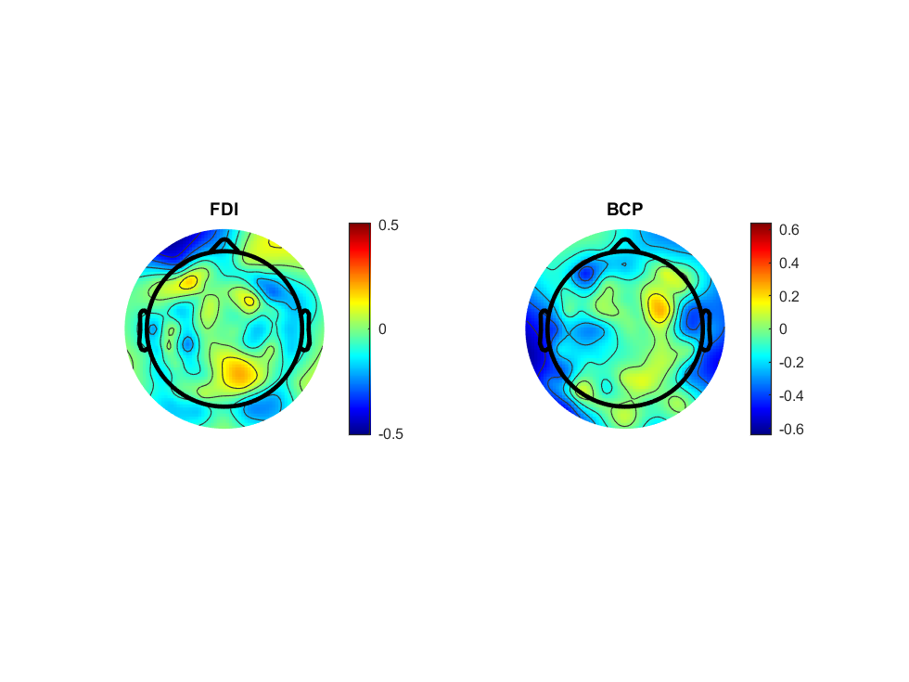
MuBeta_SL_FDIBCP.mat

Slide 24
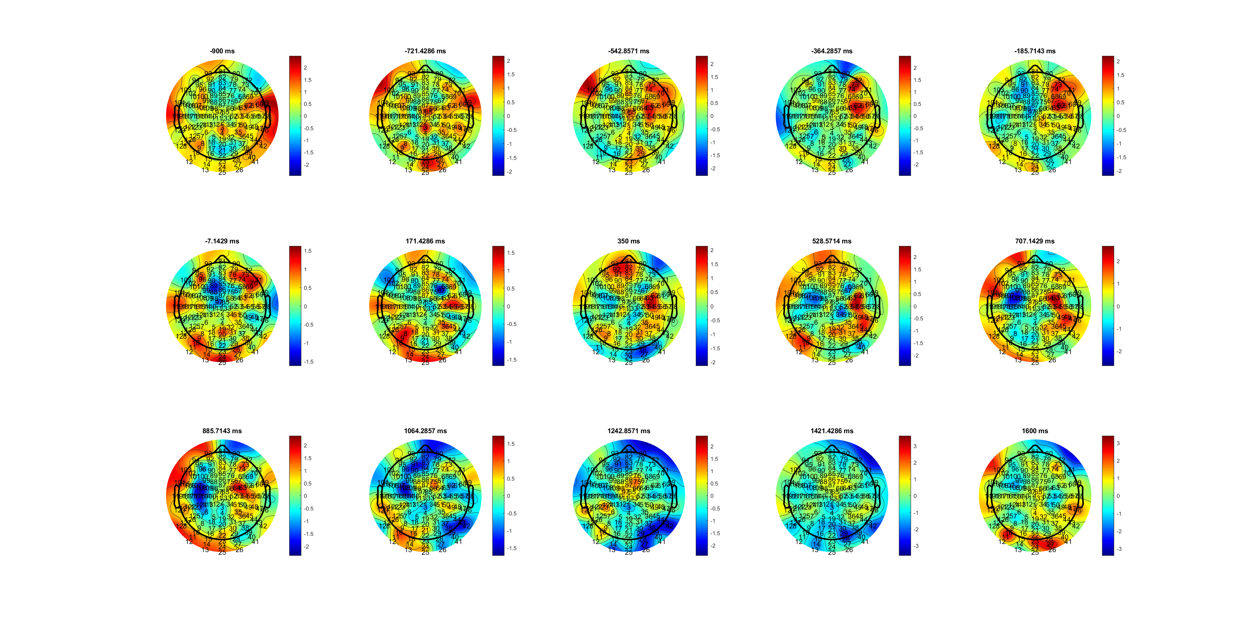
FDI QRT 350-885
Delta_SL_FDIBCP.mat

Slide 25
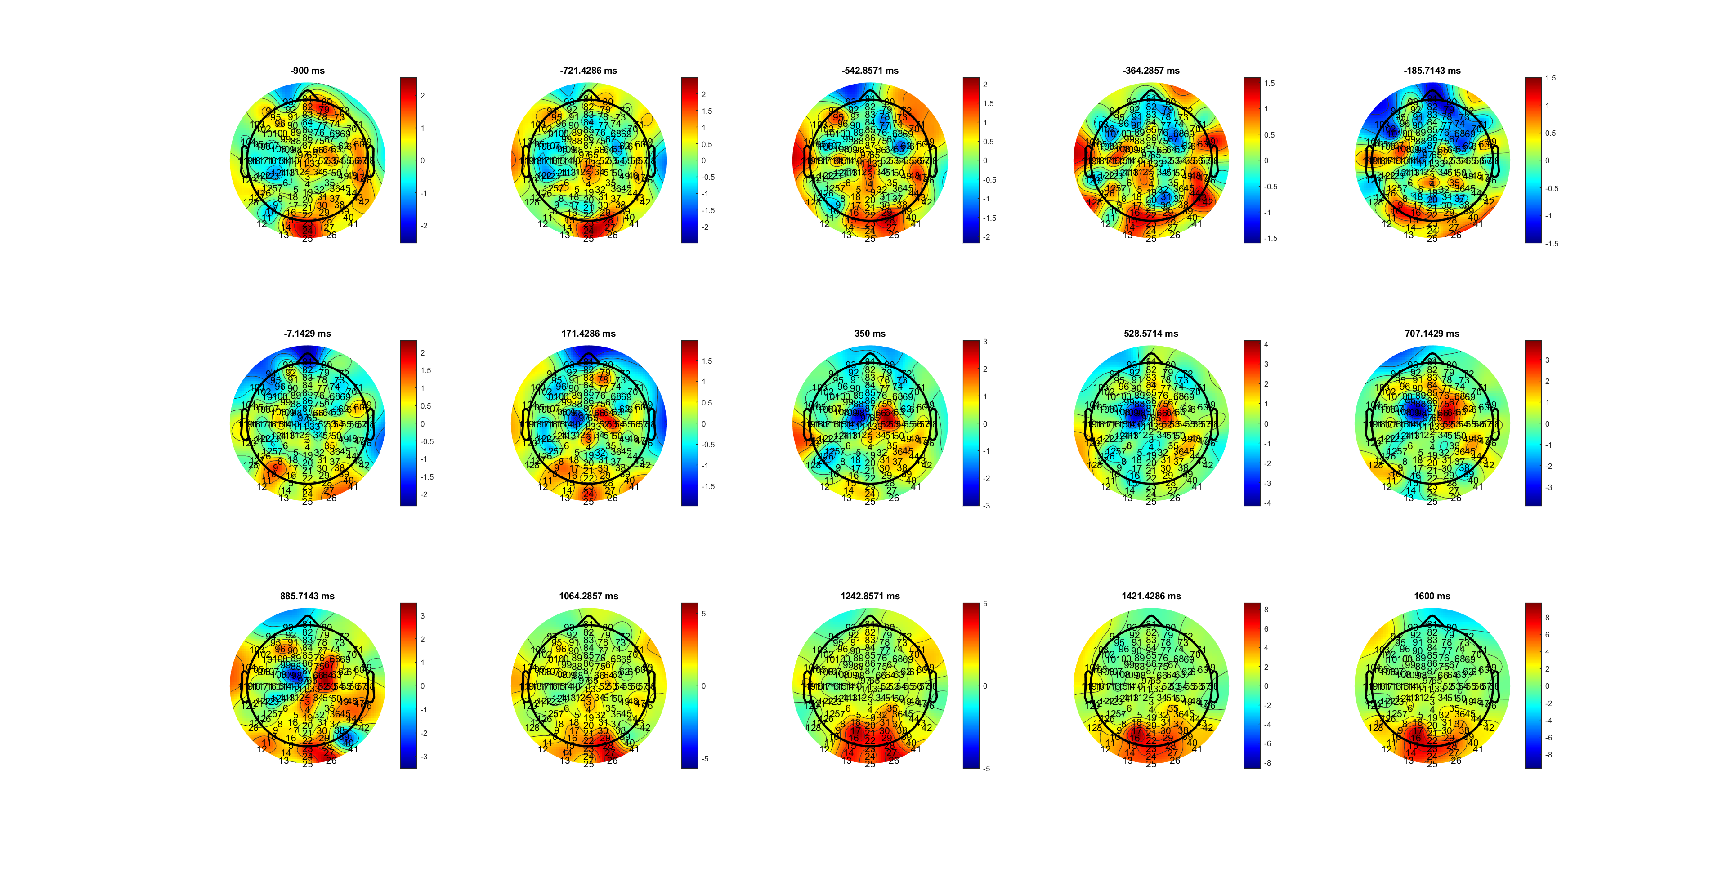
BCP QRT 171-885
Delta_SL_FDIBCP.mat

Slide 26
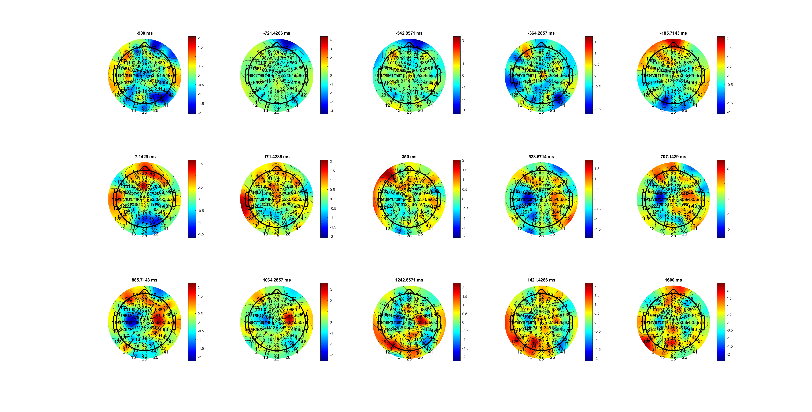
FDI MDT 528-1242
Delta_SL_FDIBCP.mat

Slide 27
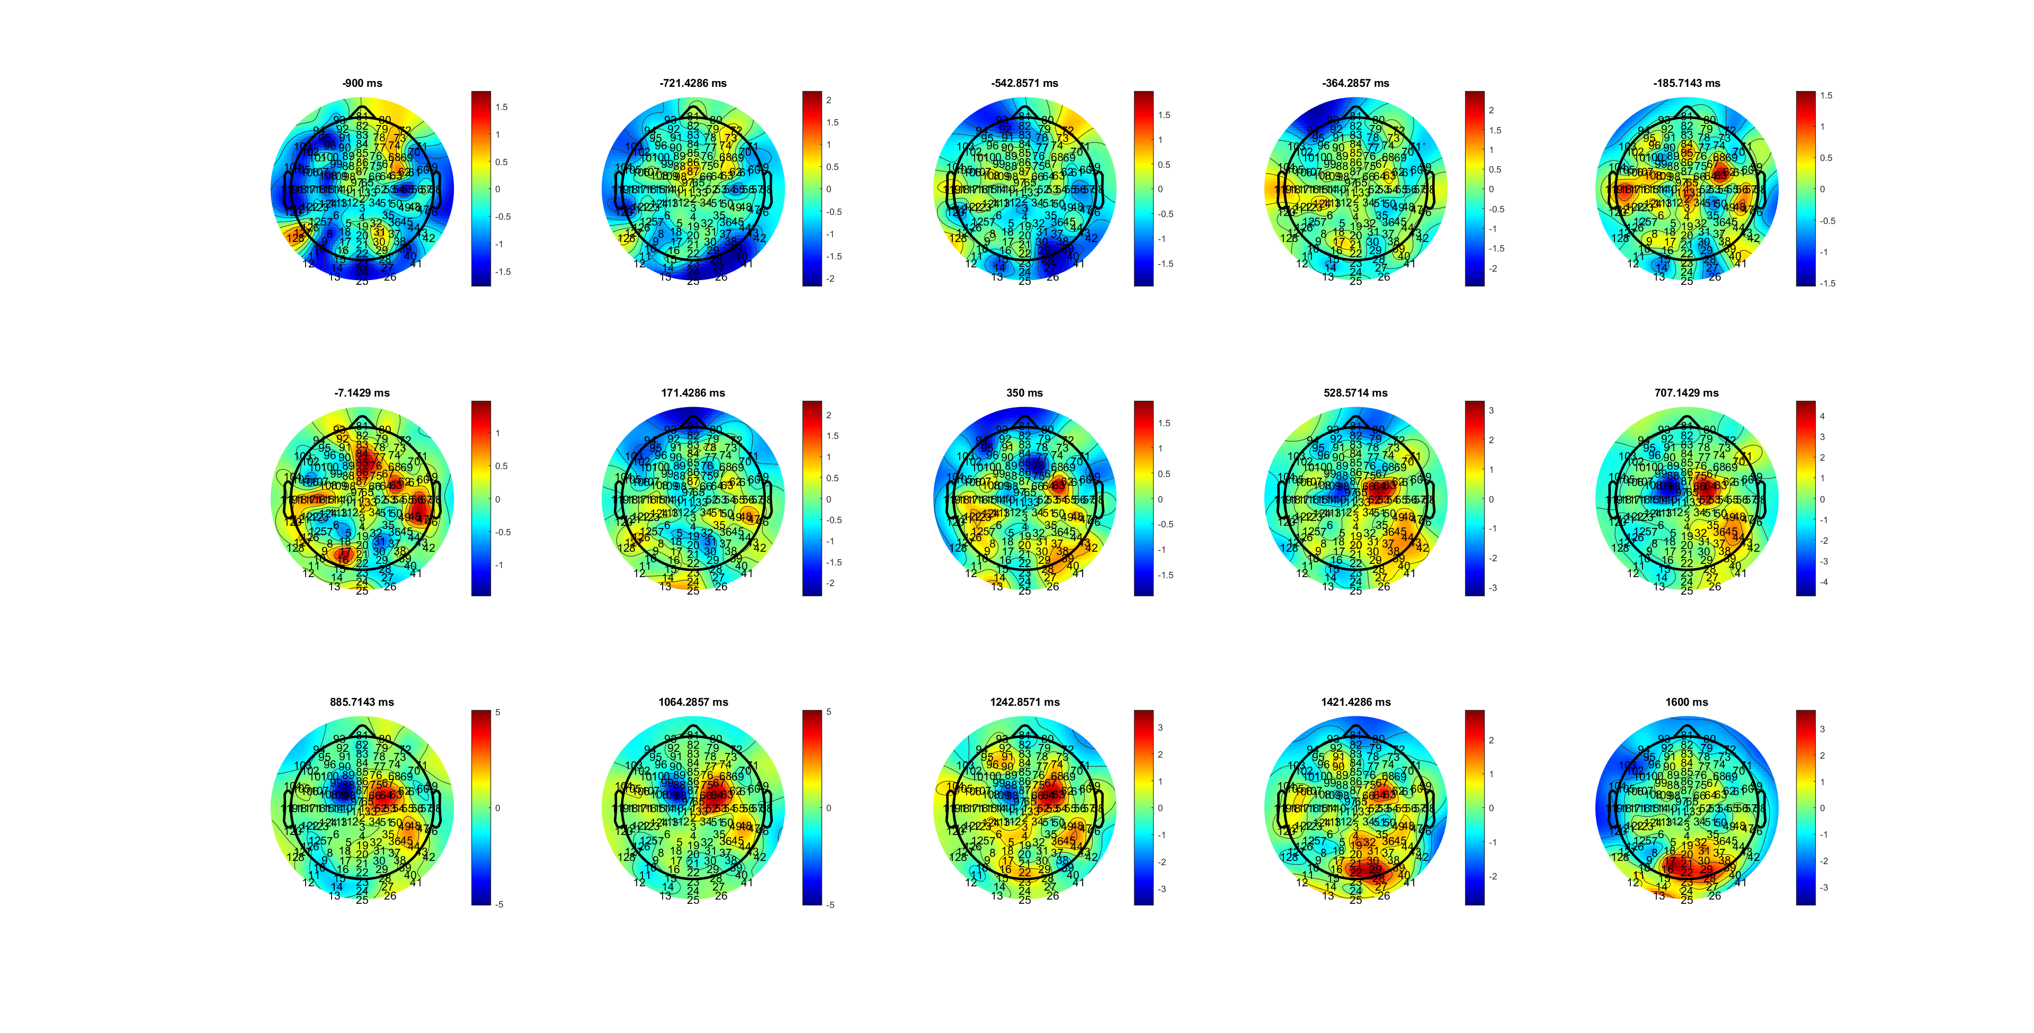
BCP MRT 528-1242
Delta_SL_FDIBCP.mat

Slide 28
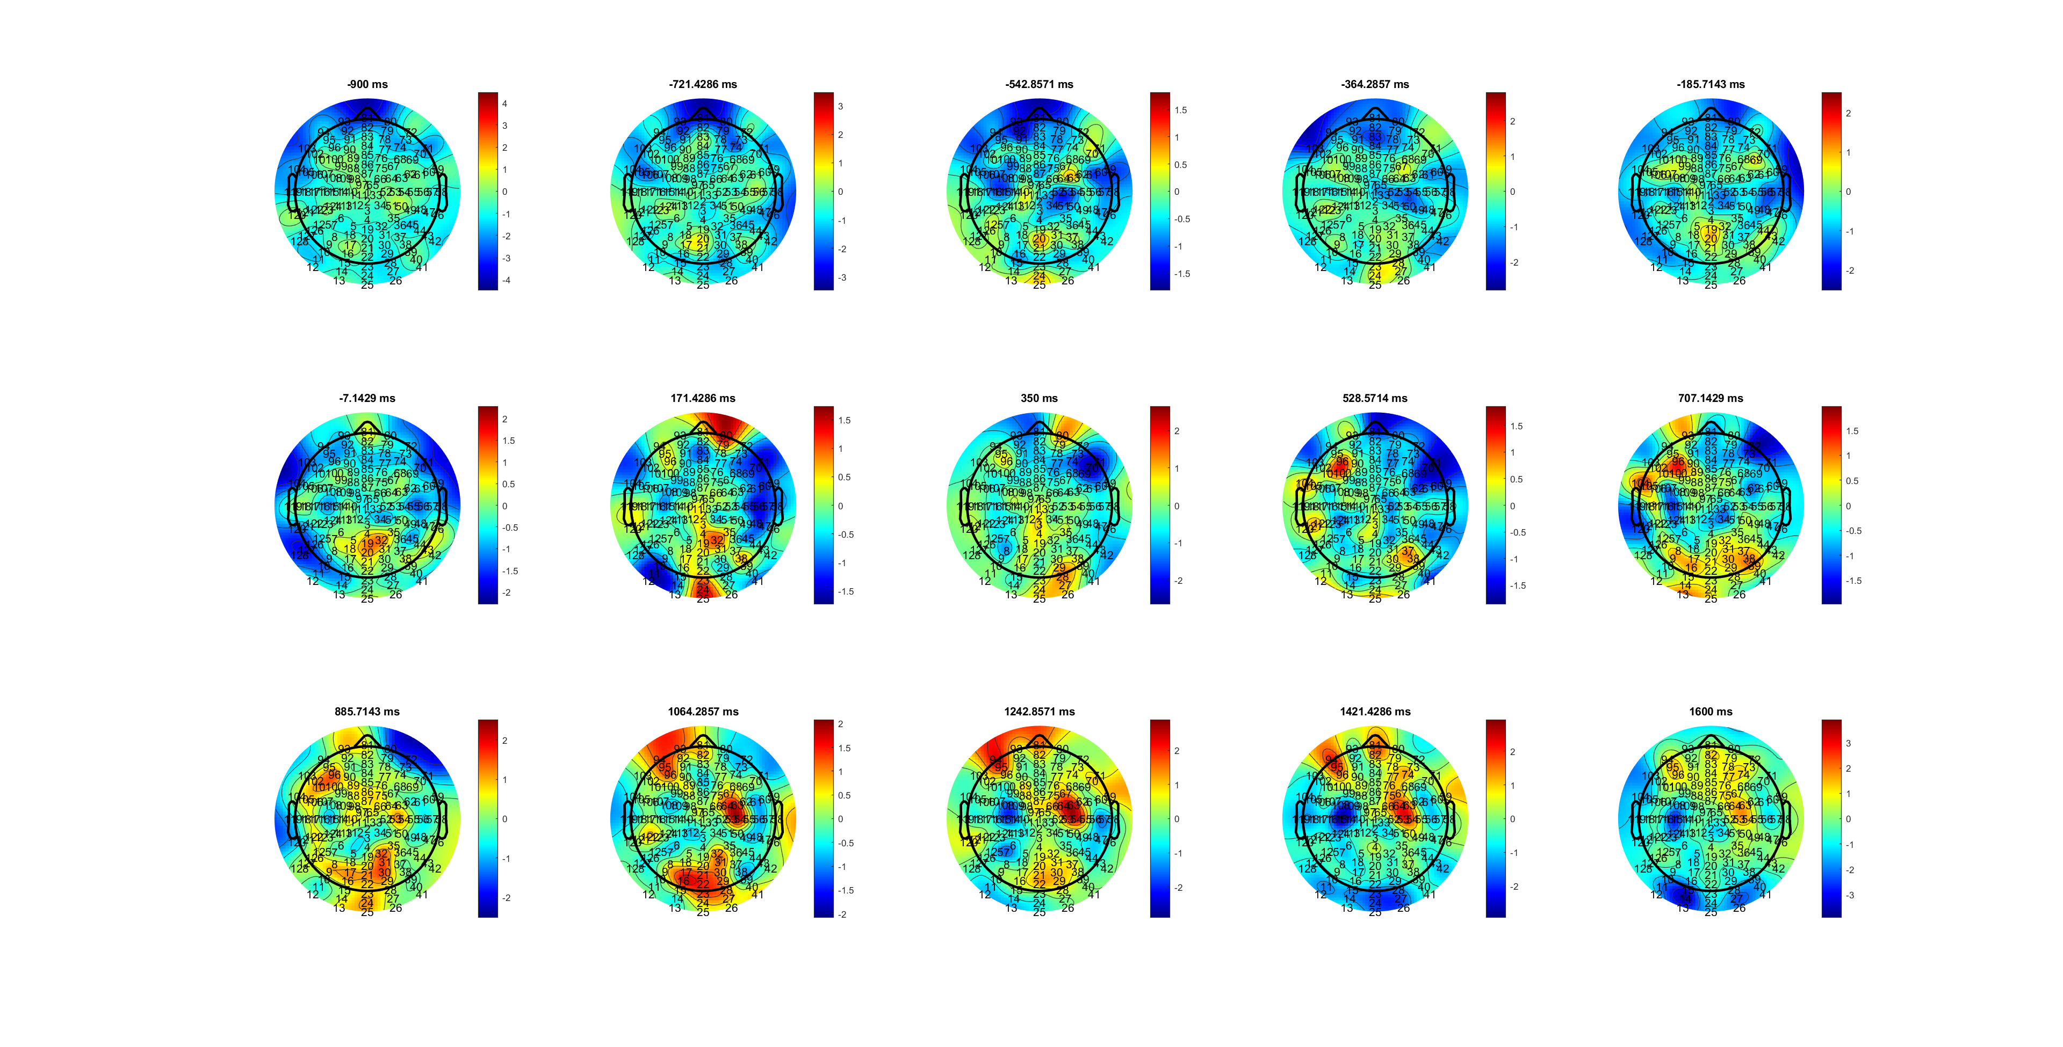
FDI SRT 1064-1420
Delta_SL_FDIBCP.mat

Slide 29
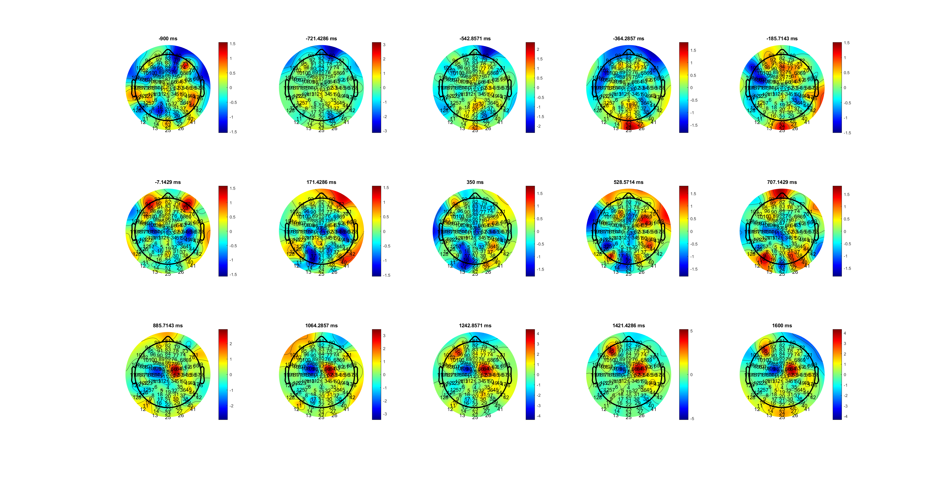
BCP SRT 885-1600
Delta_SL_FDIBCP.mat

Slide 30
FDI range changeable/ happen late
BCP range stable and strength stable

Slide 31
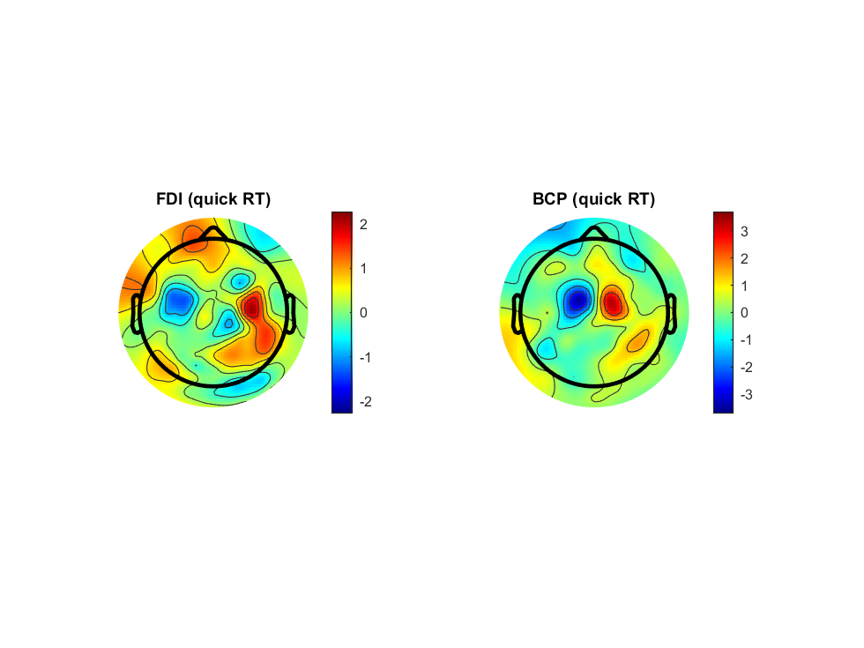
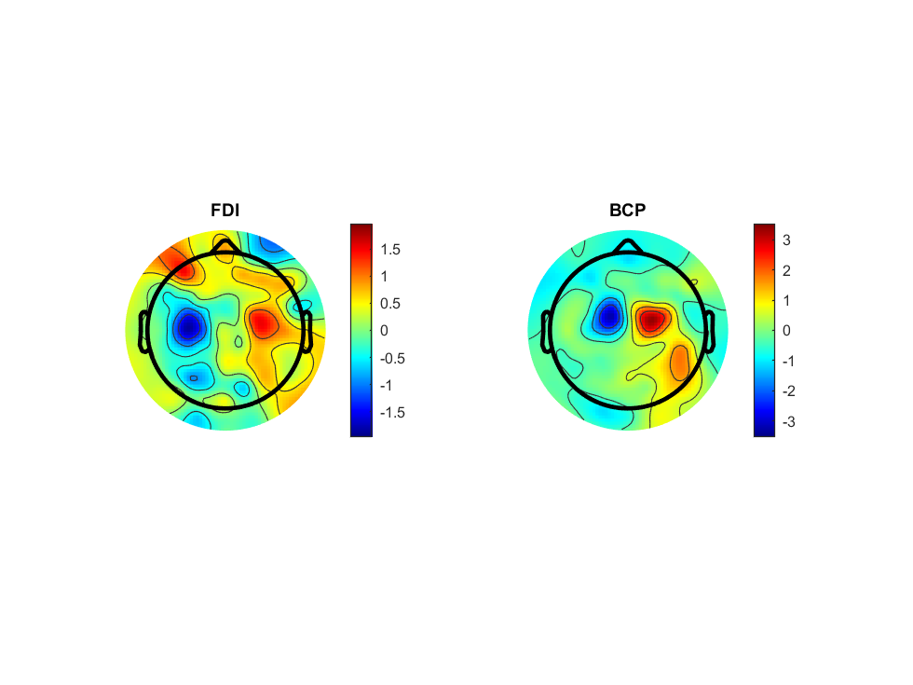
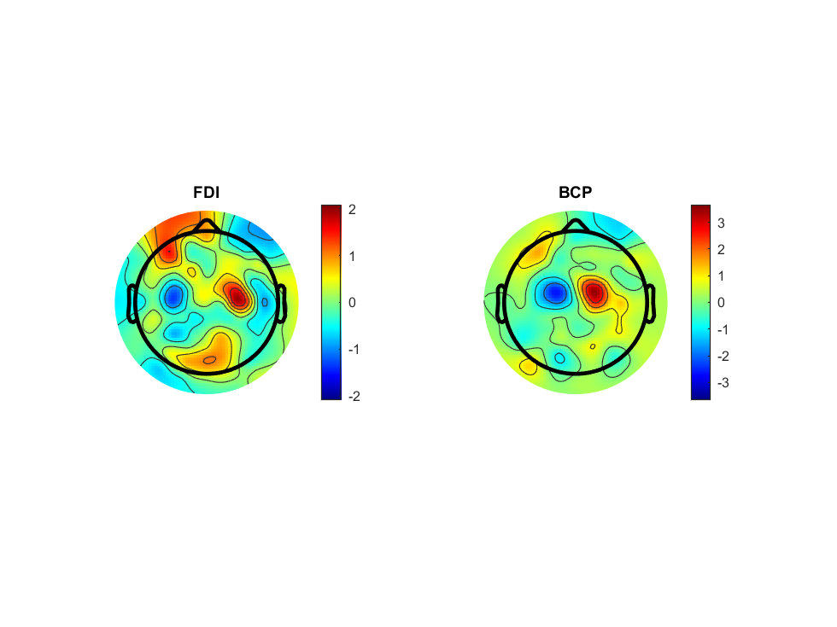
Delta_SL_FDIBCP.mat

Slide 32
RL

Slide 33
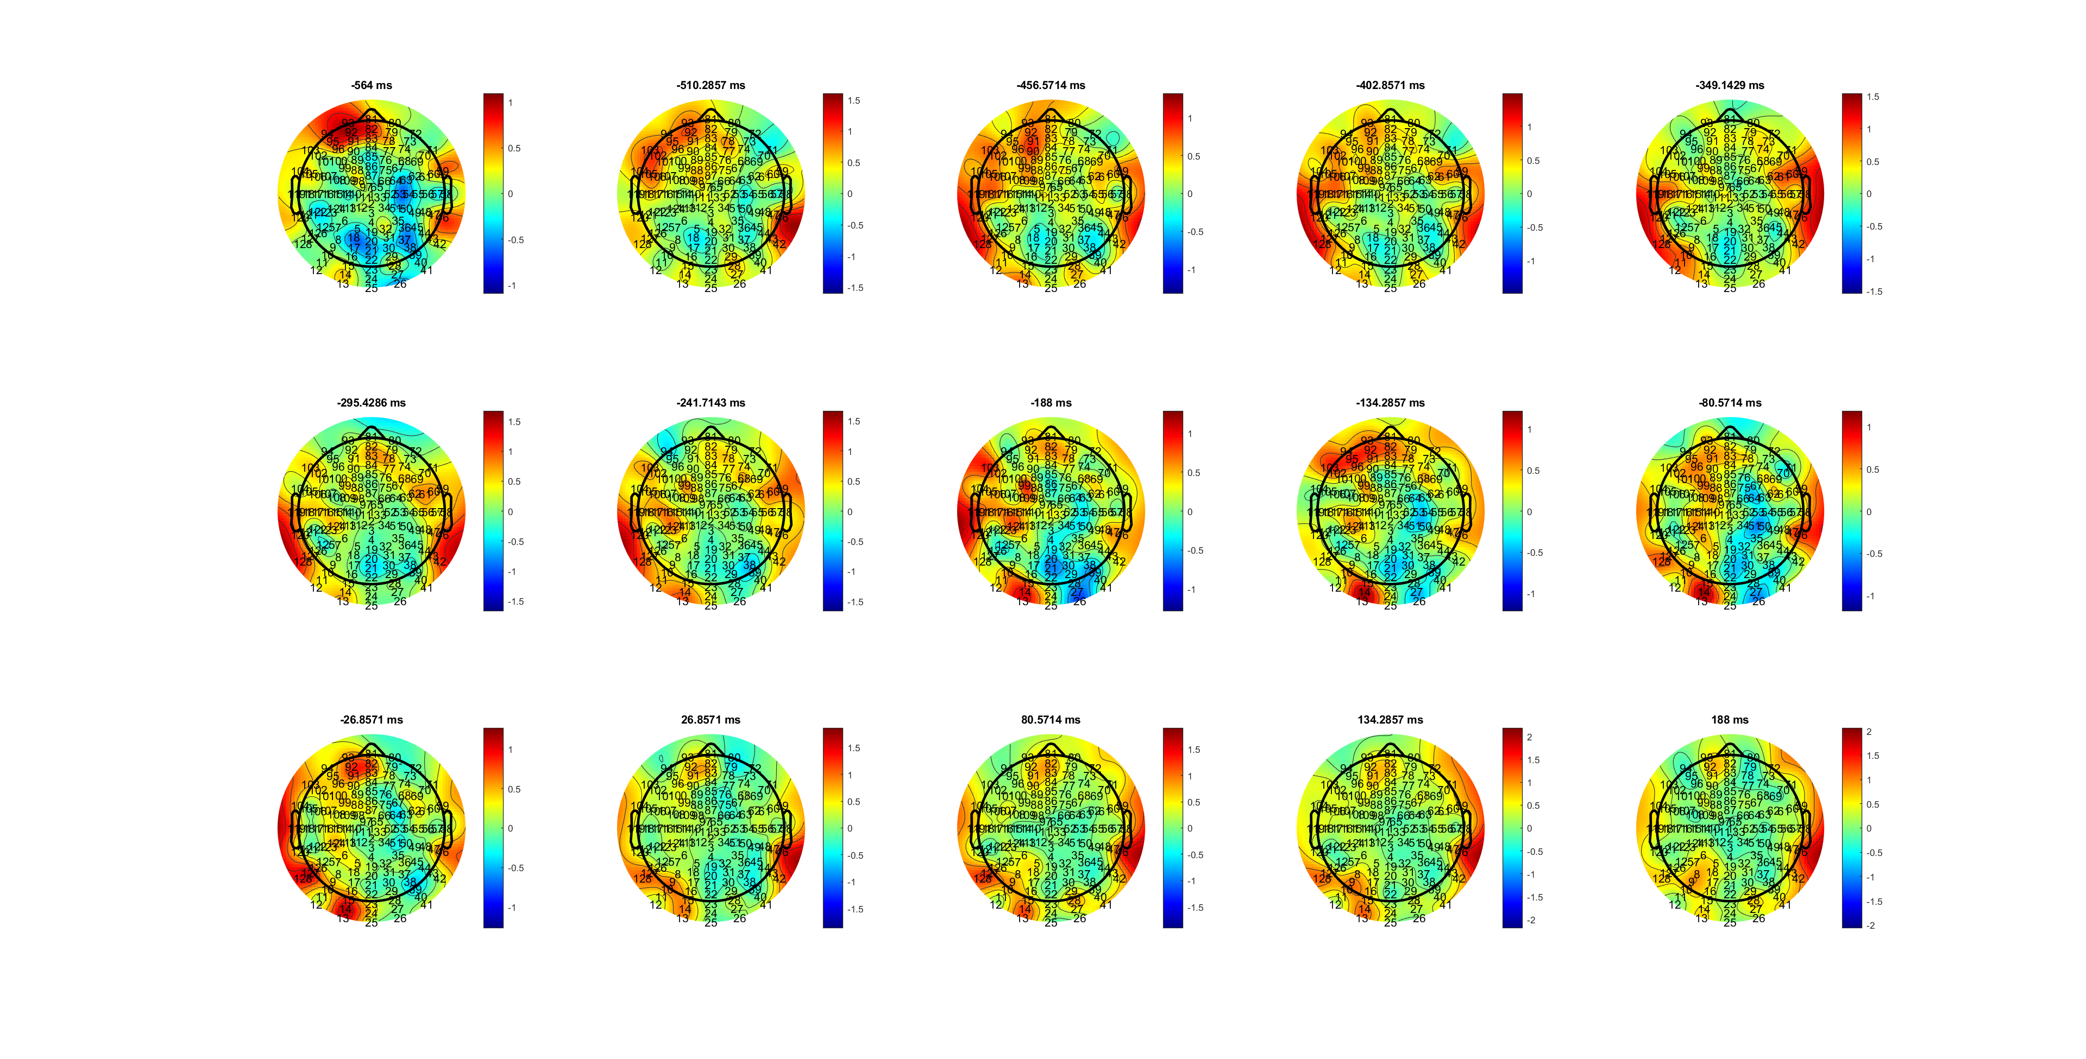
H QRT -241-0
MuBeta_RL_HL.mat

Slide 34
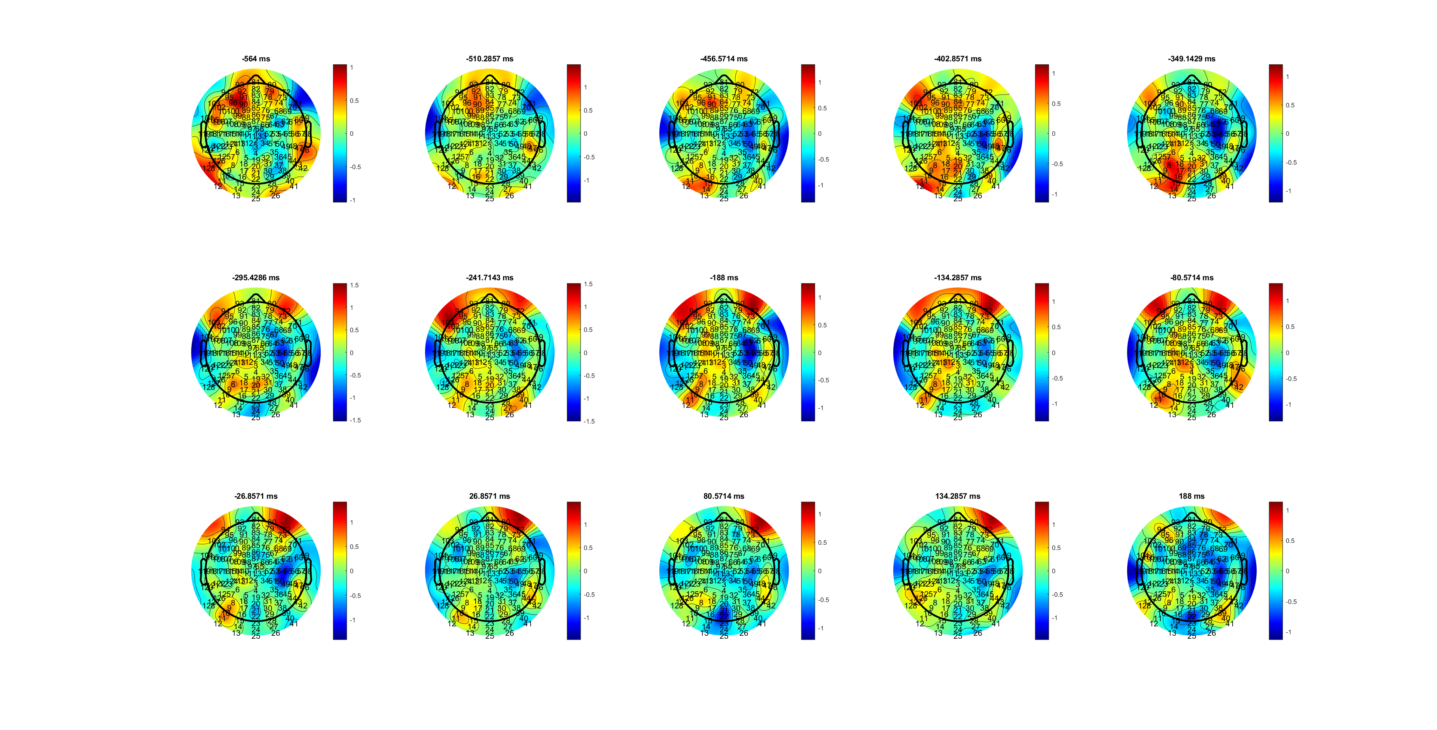
L QRT -402- -80
MuBeta_RL_HL.mat

Slide 35
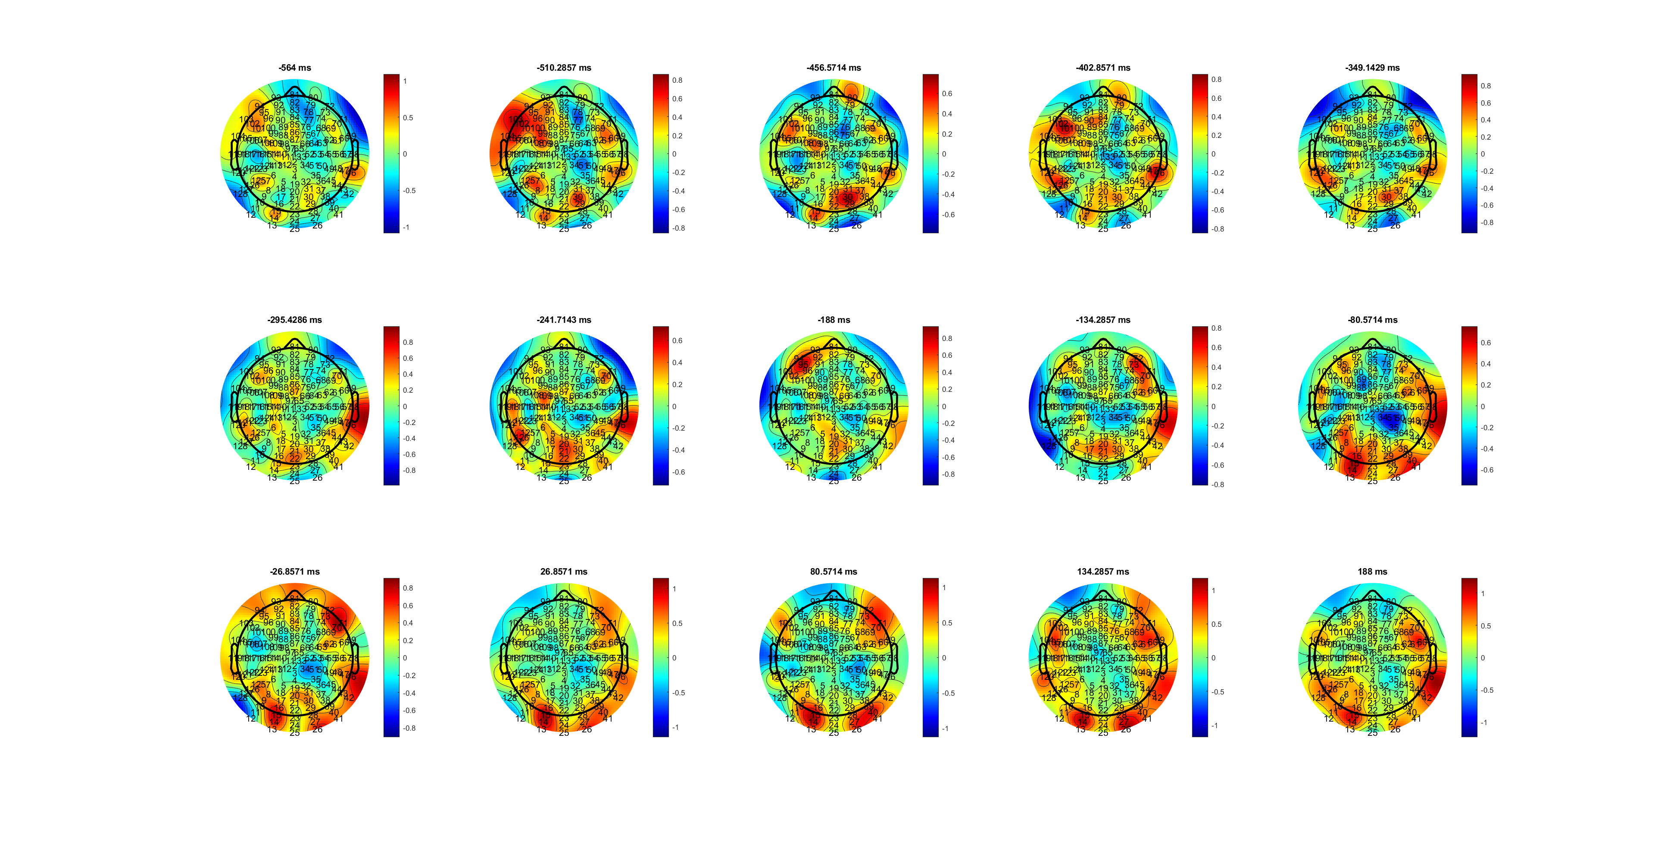
H MRT -241- -26
MuBeta_RL_HL.mat

Slide 36
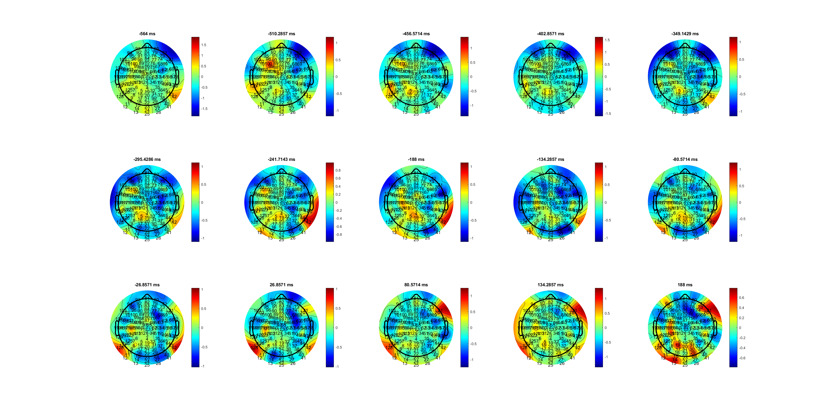
L MRT -295- 26ms
MuBeta_RL_HL.mat

Slide 37
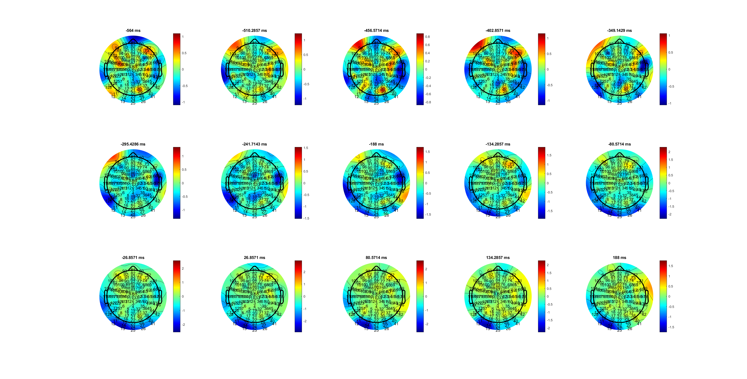
H SRT -26-188
MuBeta_RL_HL.mat

Slide 38
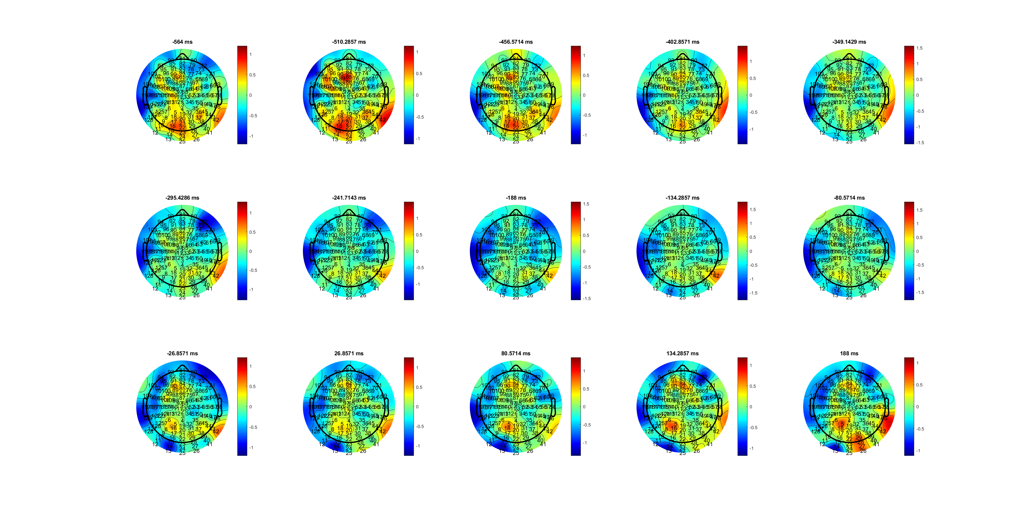
L SRT -26-134ms
MuBeta_RL_HL.mat

Slide 39
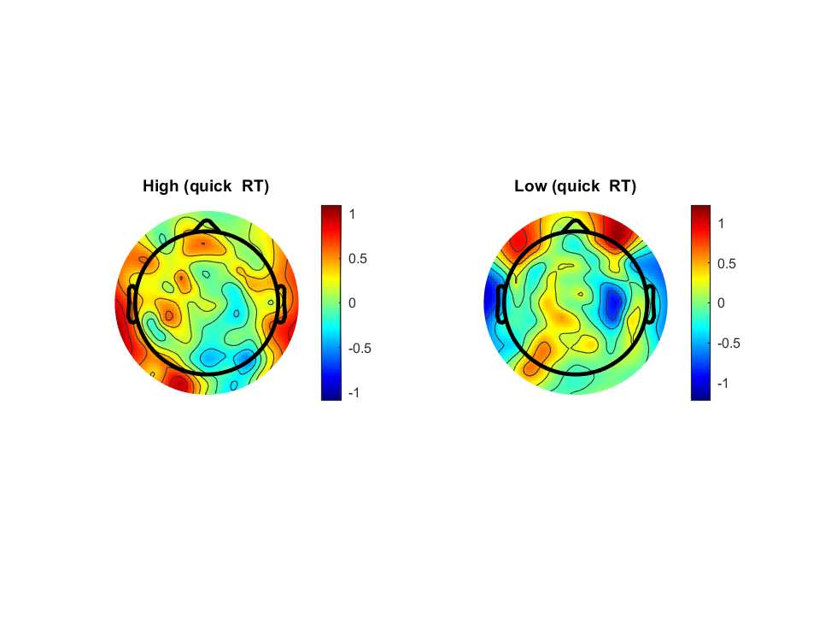
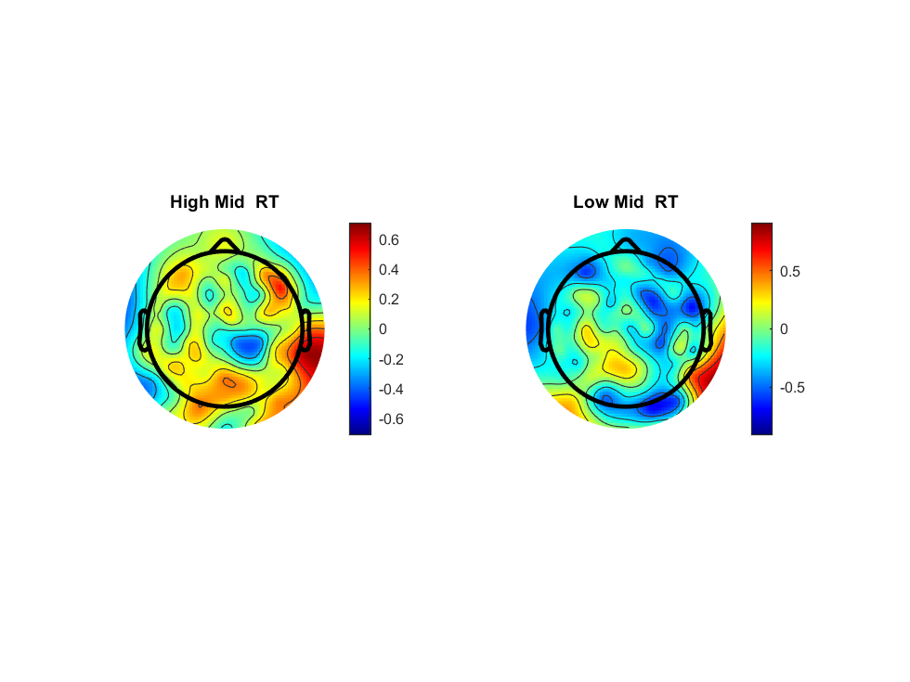
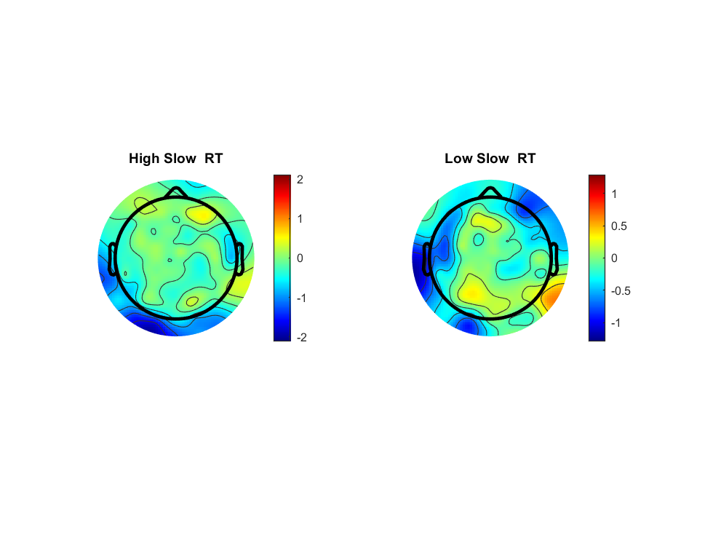
MuBeta_RL_HL.mat

Slide 40
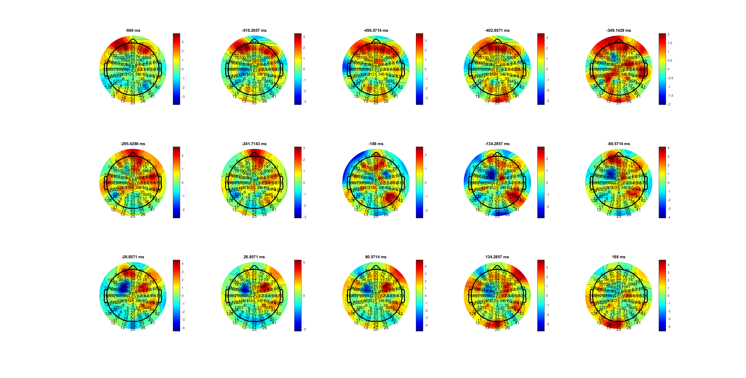
H QRT -134-134
Delta_RL_HL.mat

Slide 41
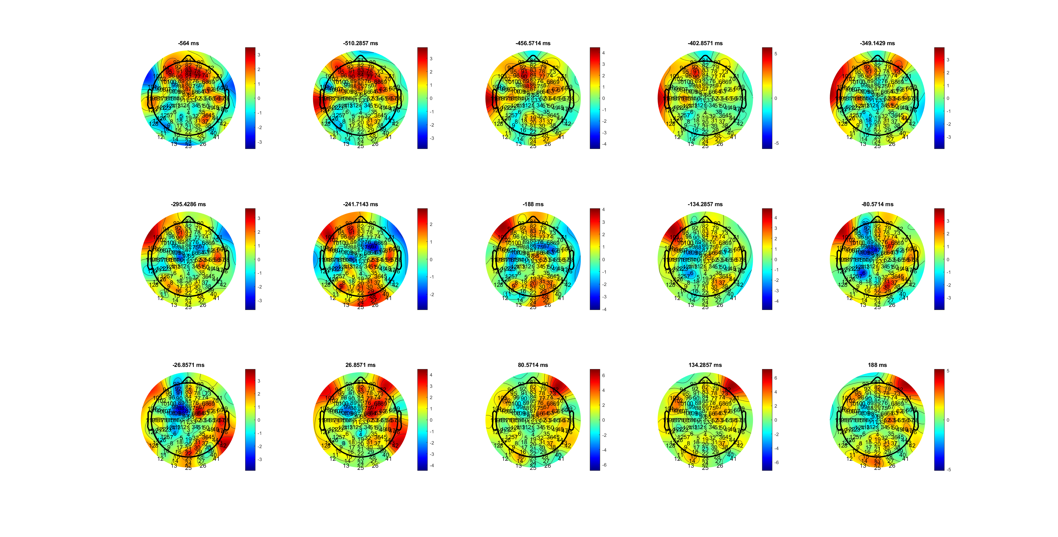
L QRT -80-80
Delta_RL_HL.mat

Slide 42
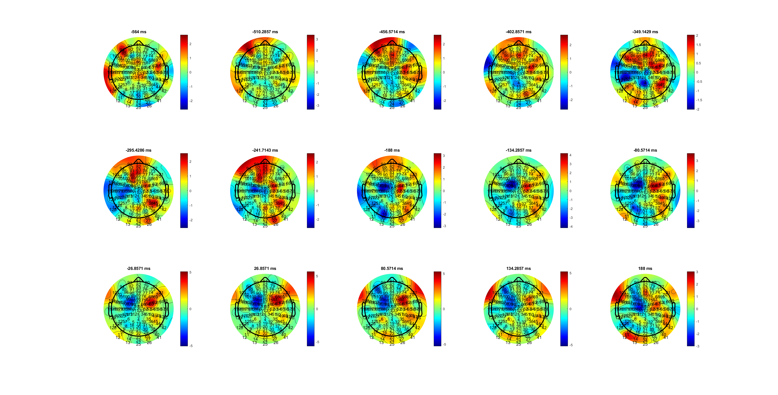
H MRT -349-188
Delta_RL_HL.mat

Slide 43
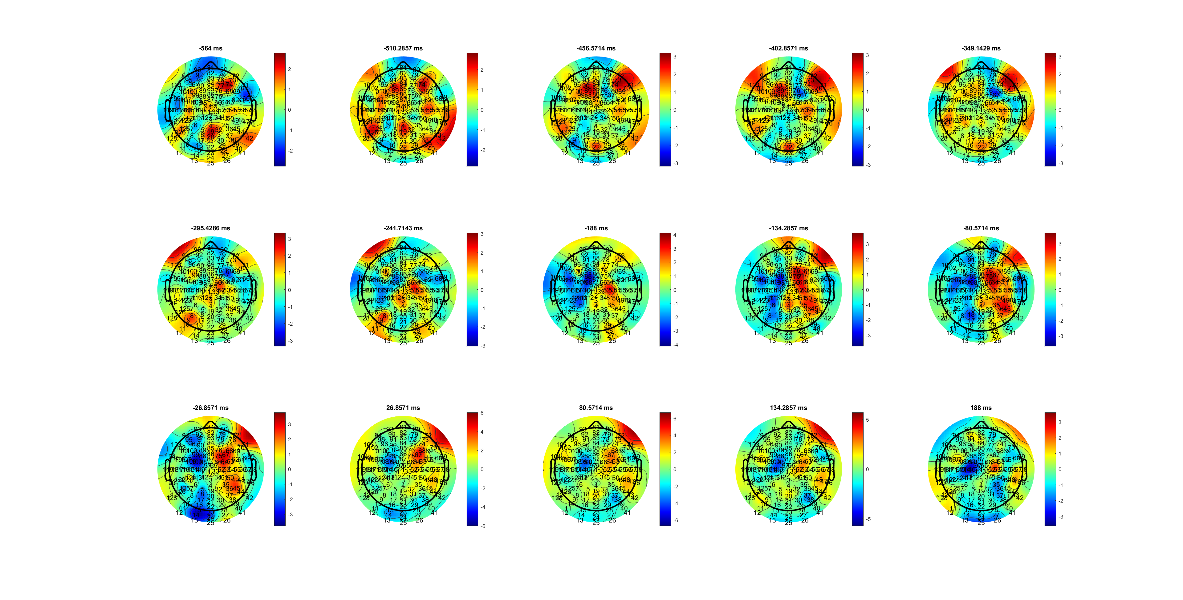
L MRT -188-188 what at -402??
Delta_RL_HL.mat

Slide 44

H SRT (-188-188)
Delta_RL_HL.mat

Slide 45

L SRT -349-188
Delta_RL_HL.mat

Slide 46



Front to back?
Delta_RL_HL.mat

Slide 47



RT increase- slope decrease; BCP higher slop
MuBeta_RL_FDIBCP.mat

Slide 48



FDI durtuion short; BCP -188 stable
Delta_RL_FDIBCP.mat

Slide 49

FDI 63 108

Slide 50

BCP 64 109

Slide 51
EOL

Slide 52
MuBeta_EOL_HL

Slide 53
Delta_EOL_HL

Slide 54



Delta_EOL_FDIBCP

